Slide 1
Using Exact Sciences Models for Understanding Social Phenomena Uncovering network structure from Diffusion Data
Sria Louis
School of Business Administration, The Hebrew University
Course # 55772
Notes:
Sria Louis
Purpose : real usage of Exact Science modeling in the business world
Unlike other classes : we are not going just to learn a model, but to USE it
What did work? What didn’t work? Why?

Slide 2
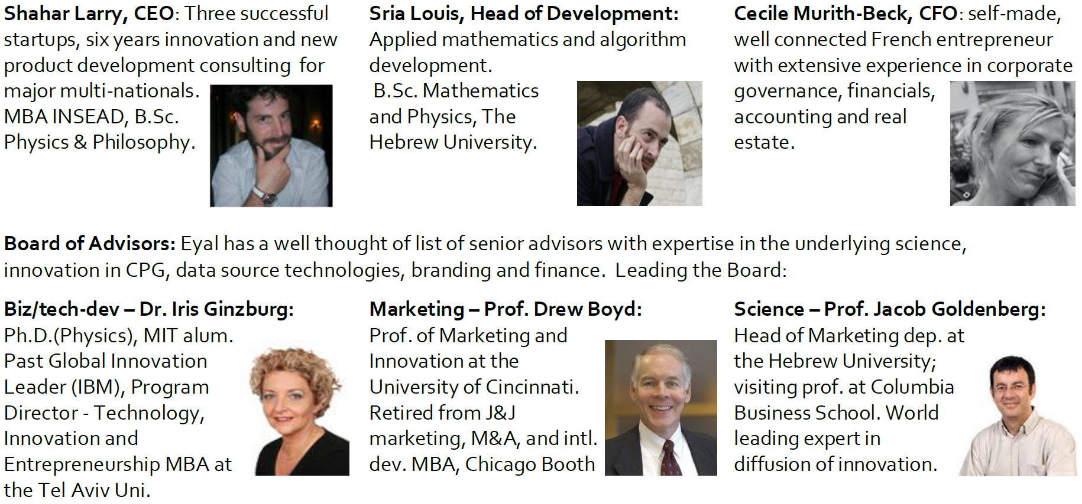
Credit
Based on:
Garber, Tal, Jacob Goldenberg, Barak Libai and Eitan Muller (2004) From Density to Destiny: Using Spatial Analysis for Early Prediction of New Product Success, Marketing Science Vol. 23, 3, p 419-29.
Goldenberg, Jacob, Lowengart Oded and Daniel Shapira (2009) Zooming In: Self-Emergence of Movements in New Product Growth, Marketing Science, Vol. 28, 2, March-April 2009, p. 274-92.
Network Traces on Penetration: Uncovering Degree Distribution from Adoption Data In Marketing Science (2012) Coauthor(s): Dover Yaniv, Jacob Goldenberg, Daniel Shapira

Slide 3
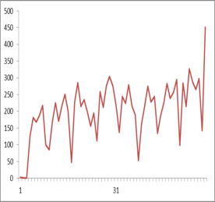
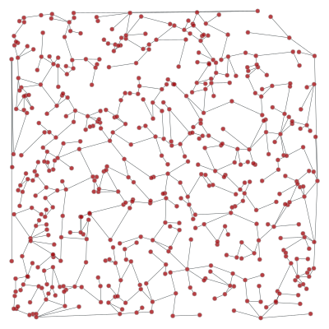
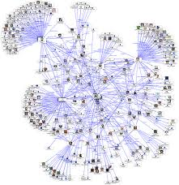
WoM
Advertising does not sell new products – WoM does!
recommendation > X10 commercial.
But we cannot see the network!
?

Slide 4
Reminder
Bass (1969):
m nodes – all connected
Probability p adopting a product after being exposed to advertisement
Probability q adopting a product due to WoM
J Goldenberg, B Libai, E Muller (2002)
m nodes – all connected
Different p and q
Y Dover, J Goldenberg, D Shapira (2012):
In reality not all people are connected!

Slide 5
Lecture map
The “Typical” Social Networks
Degree Distribution
From Bass Model – to a “Typical” Social network
A glance to the differential equation
How can we use it? Numerical Solution
How do we make money out of it?
Why I am not rich?

Slide 6
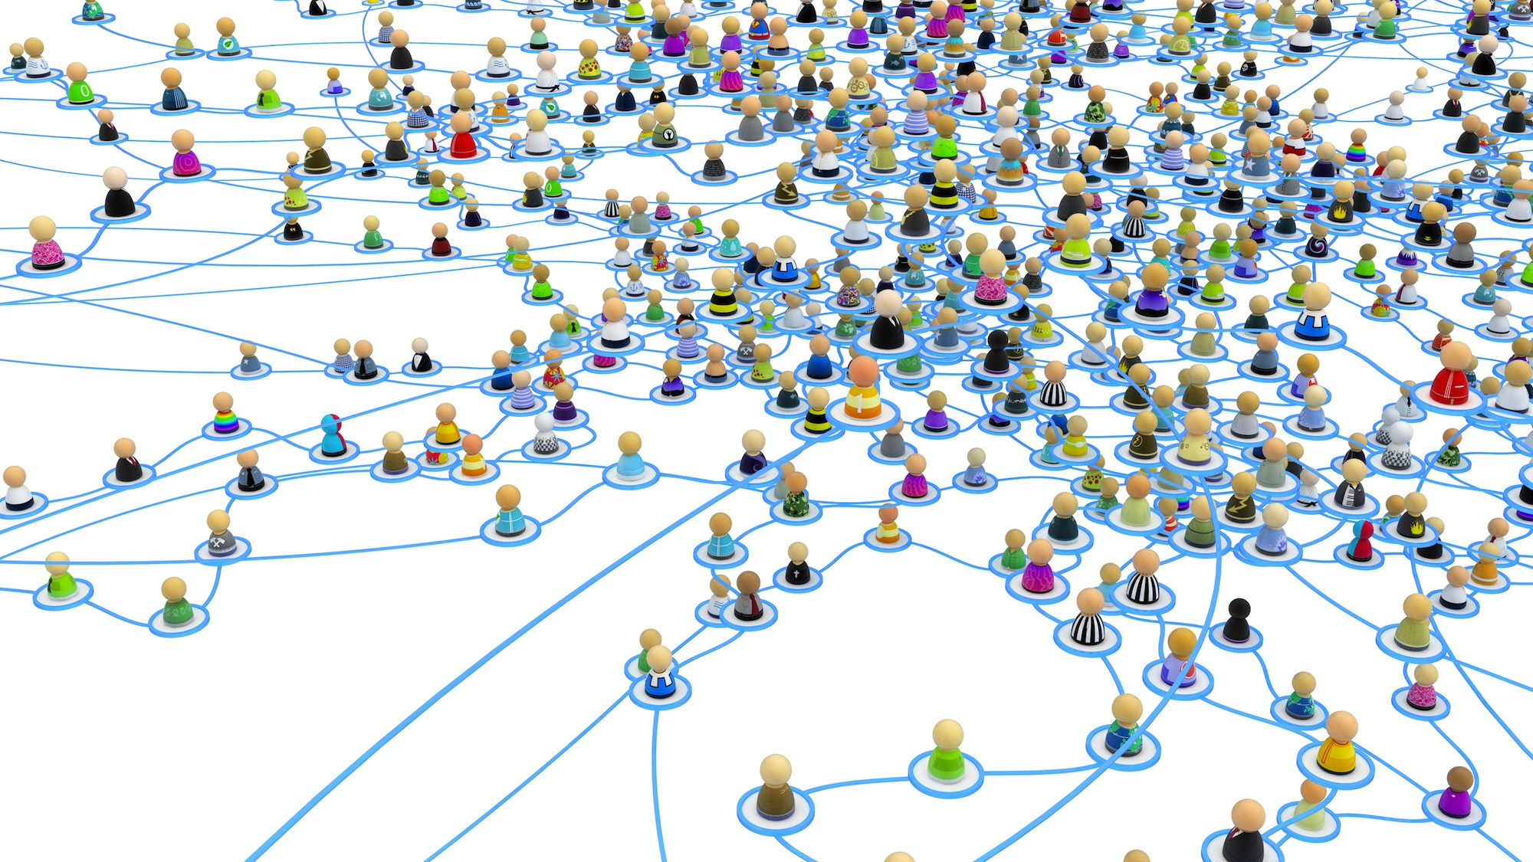
The “Typical” Social Networks

Slide 7
Degree Distribution
Captures the essence of a (social) network
Degree = Number of neighbors
$m_{k}=$ Number of nodes of degree $k$
What was the degree distribution in the basic Bass Model?

Slide 8
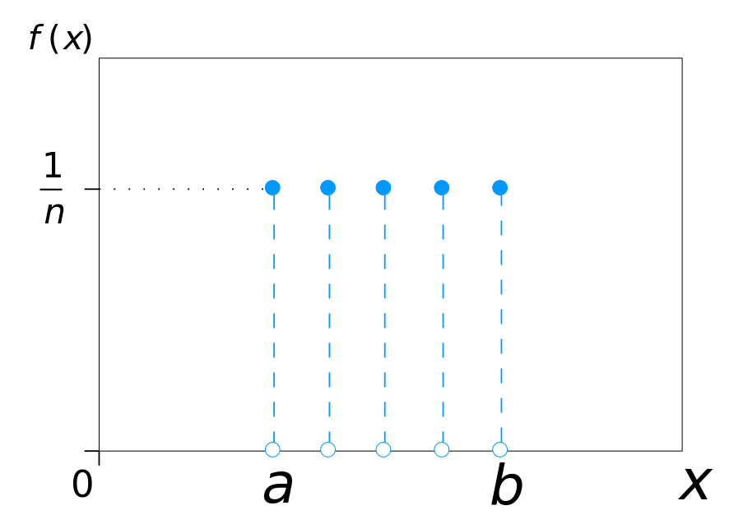
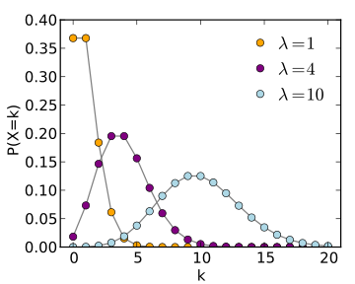
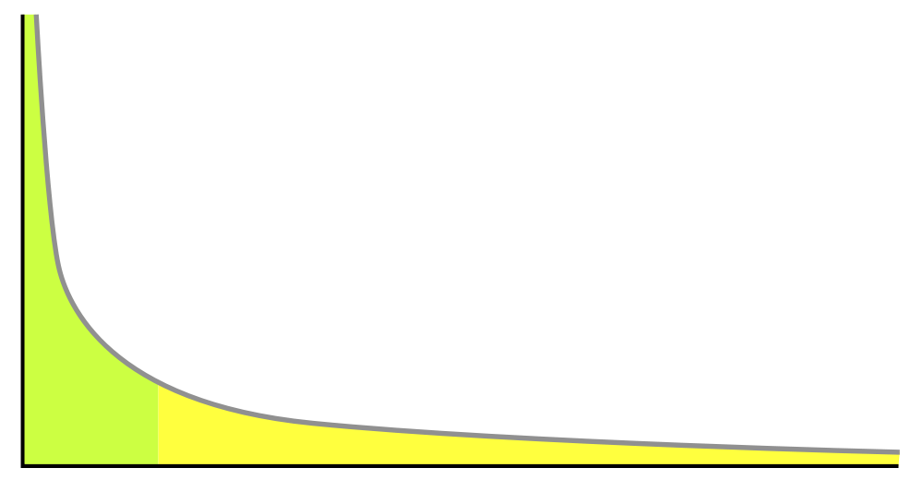
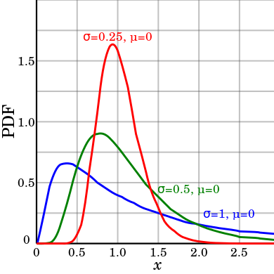
Typical Degree Distribution
Scale-free | Lognormal | Poissonian | Uniform
$$k^{−α}$$ $$2.1≤α≤2.9$$ $$k_{min}≤k$$ | $$e^{−\frac{{(ln\left(k\right)−μ)}^{2}}{2σ^{2}}}$$ | $$\frac{λ^{k}e^{−λ}}{k!}$$ | $$a≤k≤b$$
Notes:
k alpha
Each distribution can be described by up to 2 parameters

Slide 9
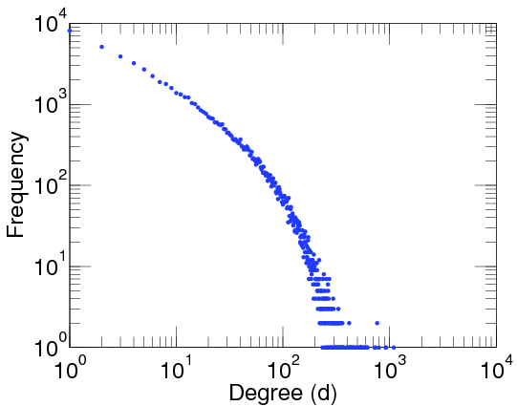
Degree Distribution : Examples
uniform network: ${8≤m}_{k}≤10$
Bass Model
$$m_{k}=\{\begin{matrix}m & \text{if} k=m−1 \\ 0 & \text{else}\end{matrix}$$
Facebook Degree Distribution (scale-dree)
WOSN 2009 Data Sets

Slide 10
From Bass Model – to a “Typical” Social network

Slide 11
From Bass Model – to a “Typical” Social network
Bass : $m_{k}=\{\begin{matrix}m & \text{if} k=m−1 \\ 0 & \text{else}\end{matrix}$
Note that the same degree distribution can generate very different graphs.
The model assumes that the degree distribution is sufficient to describe the “real” process.
DGS : $m_{k}=k^{−α}$

Slide 12
From Bass Model – to a “Typical” Social network
Denote $H_{k}(t)$ the number of people with exactly $k$ neighbors who already adopted the new product.
For instance:
$$H_{0}\left(t=0\right)=m$$
$$H_{1}\left(t=0\right)=0$$

Slide 13
The Bass diffusion model (Bass 1969)
$$\frac{dN(t)}{dt}=\left(p+q∙N\left(t\right)\right)(m−N\left(t\right))$$
Market
size
Number of adopters
External
influence
Internal
Influence
Current market potential

Slide 14
A glance to the differential equation
Bass:
$$\frac{dN(t)}{dt}= \left(p+q∙N\left(t\right)\right)∙(m−N\left(t\right))$$
Current market potential
Current market potential
$$\frac{dN(t)}{dt}=\sum_{k}{\left(p+q∙k\right)∙H_{k}\left(t\right))}$$
DGS:

Slide 15
How to uncover a network
There are 6 parameters we need to decide:
$Γ$ - Family of degree distributions (e.g., “all scale-free distributions”)
$α,β$- Degree distribution parameters (e.g., for scale-free, $k_{min}$ and $α$)
$m$ - Market size
$q$ - Internal force (WoM) parameter
$p$ - External forces parameter
Formally:
$$min. \left(err(data,simulate\left(\overline{x}\right))\right)$$
s.t. $\overline{x}∈\left\{m,p,q,Γ,α,β\right\}$

Slide 16
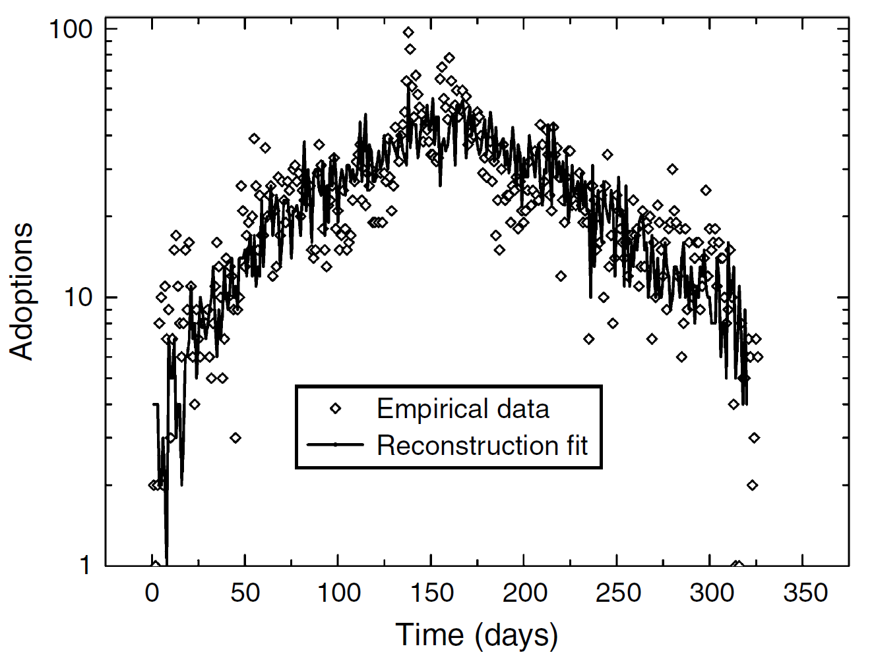
Model Evaluation
Simulated data
Friendster
Real product
Notes:
Friendster:
115M users
An estimation of the degree distribution
Note the asymmetry

Slide 17
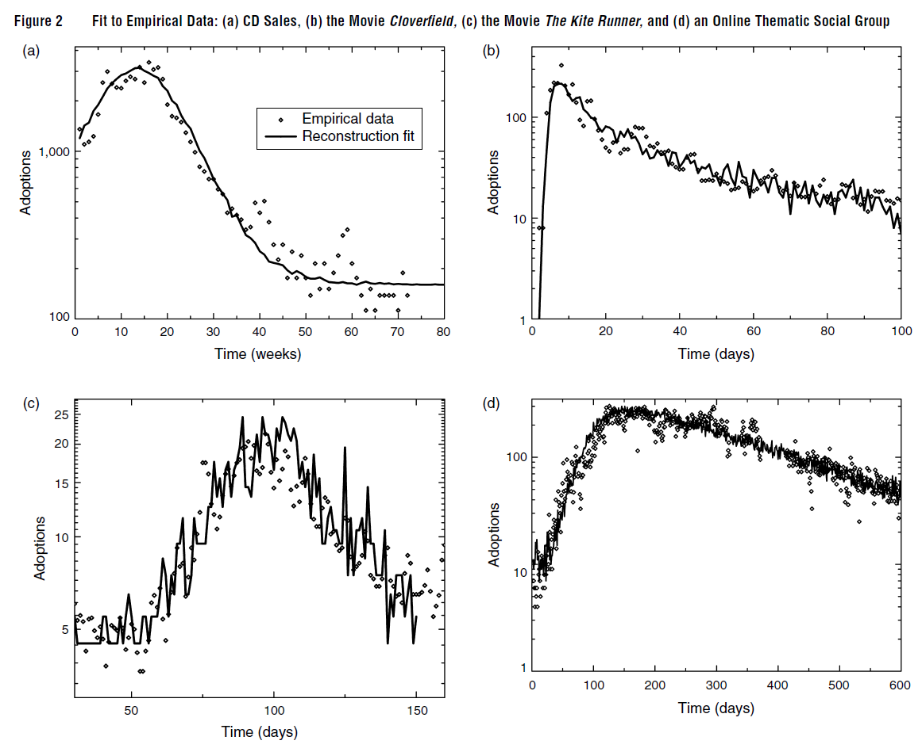
Gaussian
+
External forces
A viral online campaign
+
Lognormal
Scale-free
Gaussian
Notes:
2(a) audio CD (Moe and Fader 2001)
2(b) queries for “Cloverfield,” movie - efficient online viral marketing campaign
2(c) the movie The Kite Runner. this penetration process exhibits a low skew distribution
2(d) social group on Friendster, 74,500 users

Slide 18
Growth Stage / Decline Stage
$$\frac{dN(t)}{dt}=\sum_{k}{\left(p+q∙k\right)∙H_{k}\left(t\right))}$$
Growth: $\frac{dN(t)}{dt}\sim e^{\left(Q−3p\right)t}$
Decline: $\frac{dN(t)}{dt}\sim e^{−\left(k_{min}∙q+p\right)t}$
Conclusion:
Asymmetric exponential curve!

Slide 19
Model Evaluation
Simulated data
Friendster
Real data
…The next big step…
Notes:
Friendster:
115M users
An estimation of the degree distribution
Note the asymmetry

Slide 20
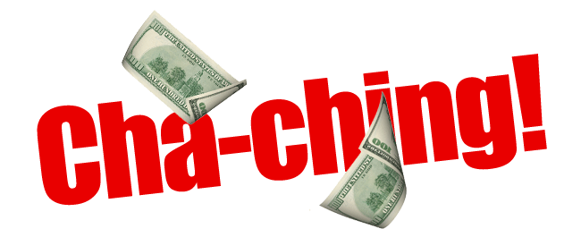
How can we make money from a model?

Slide 21
Forecast

Slide 22
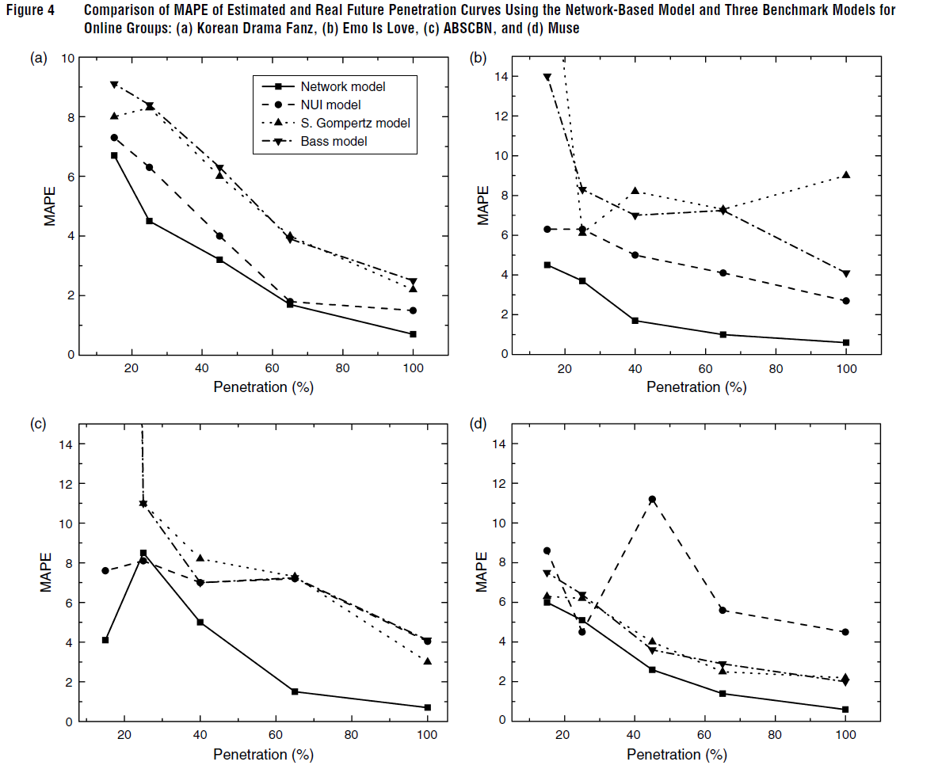
Forecast

Slide 23
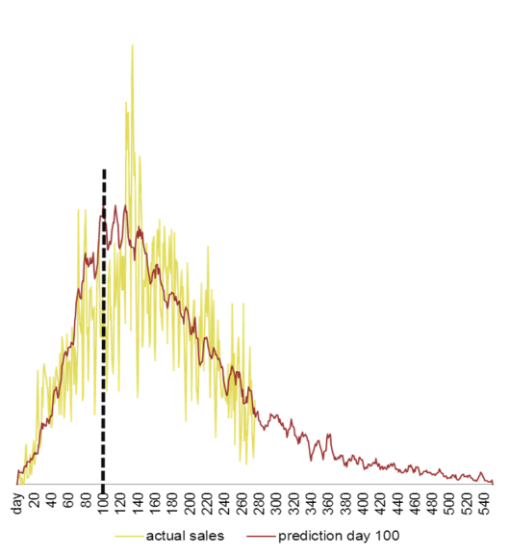
Real Example
Large European mobile provider. In yellow – real sales In red the predicted sales graph based on first 100 days Potential saving for the client: 500,000 €

Slide 24
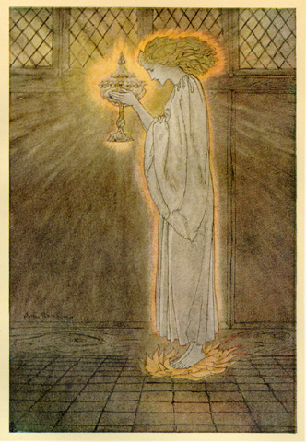
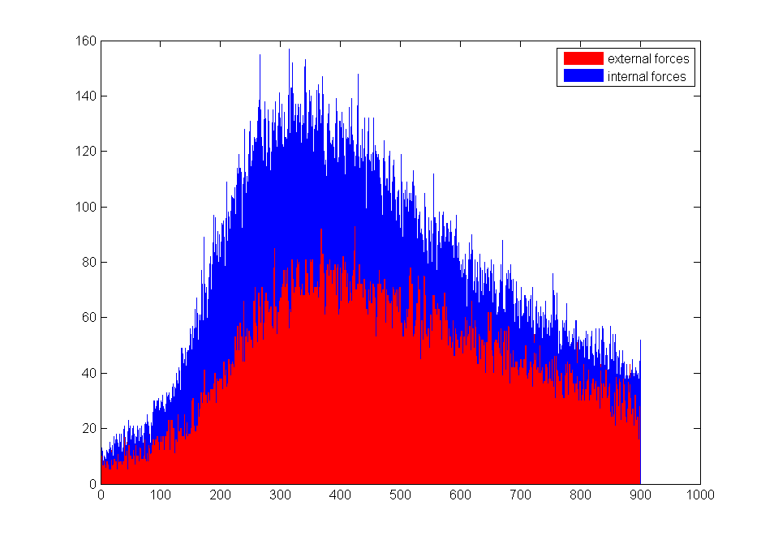
The Holly Grail: WoM
Now, we can distinguish between sales due to external forces and WoM!
Can be done for the same product on different market slices:
Age 40+ Vs. 20-30
Berlin Vs. Paris
Vienna Vs. Salzburg
Campaign: A Vs. B

Slide 25
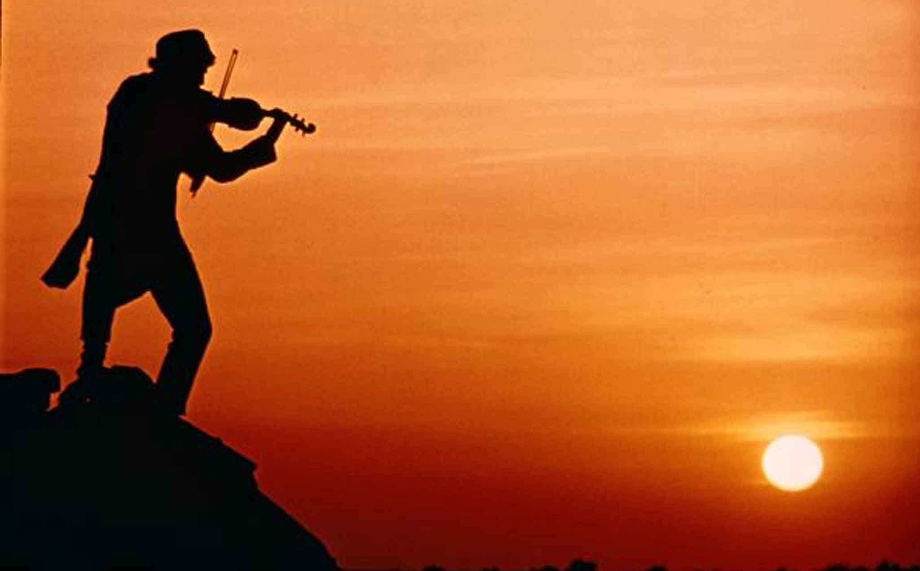
Real Example
Then…
why aren’t we rich?

Slide 26
What didn’t work?
Real life:
Non-innovative products
Cannibalism
Competing products
Weekends / Vacances
Campaigns
External Events

