Slide 1
Hereditary breast cancer – germline panel
Aviad Zick, M.D., Ph.D. Sharett Institute of Oncology
Hadassah Medical Center
E-mail – aviadz@hadassah.org.il
Phone – 050-4048024

Slide 2
Work of
Johnathan Arnon
Yusra Asli
Myriam Maoz
Achinoam Gogenheim
Michal Inbar
Mazal Tov Marwani
Tamar Peretz

Slide 3
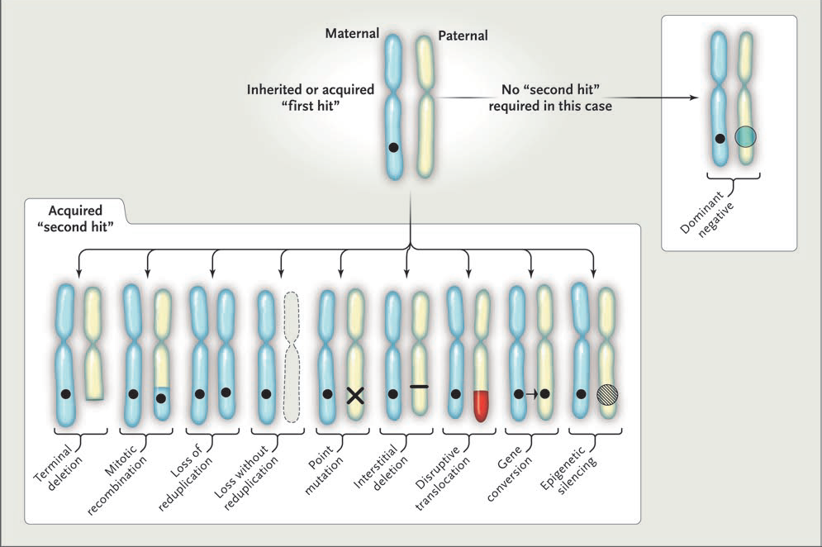
Hereditary cancer
Foulkes, NEJM, 2008, 359, 2143-53

Slide 4
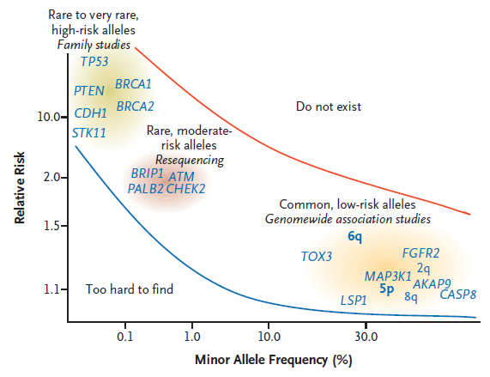
Breast cancer Susceptibility Loci and genes
Foulkes, NEJM, 2008, 359, 2143-53

Slide 5
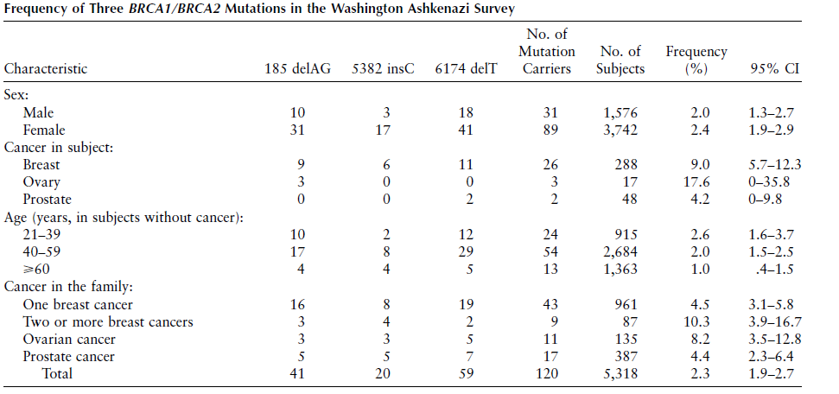
Hereditary breast cancer in Israel
Hartge et al, Am. J. Hum. Genet, 1999, 64

Slide 6
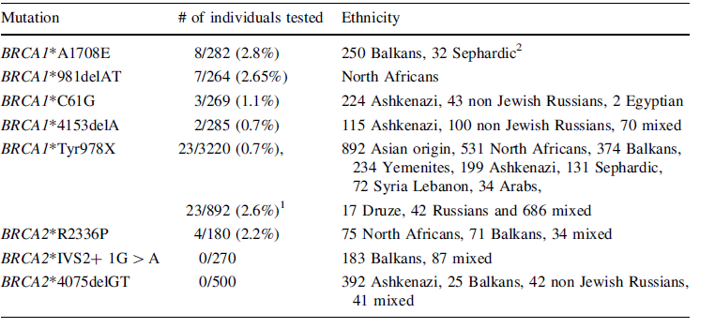
Laitman et al, Breast Cancer Res Treat, 2012, 133, 1153-57

Slide 7
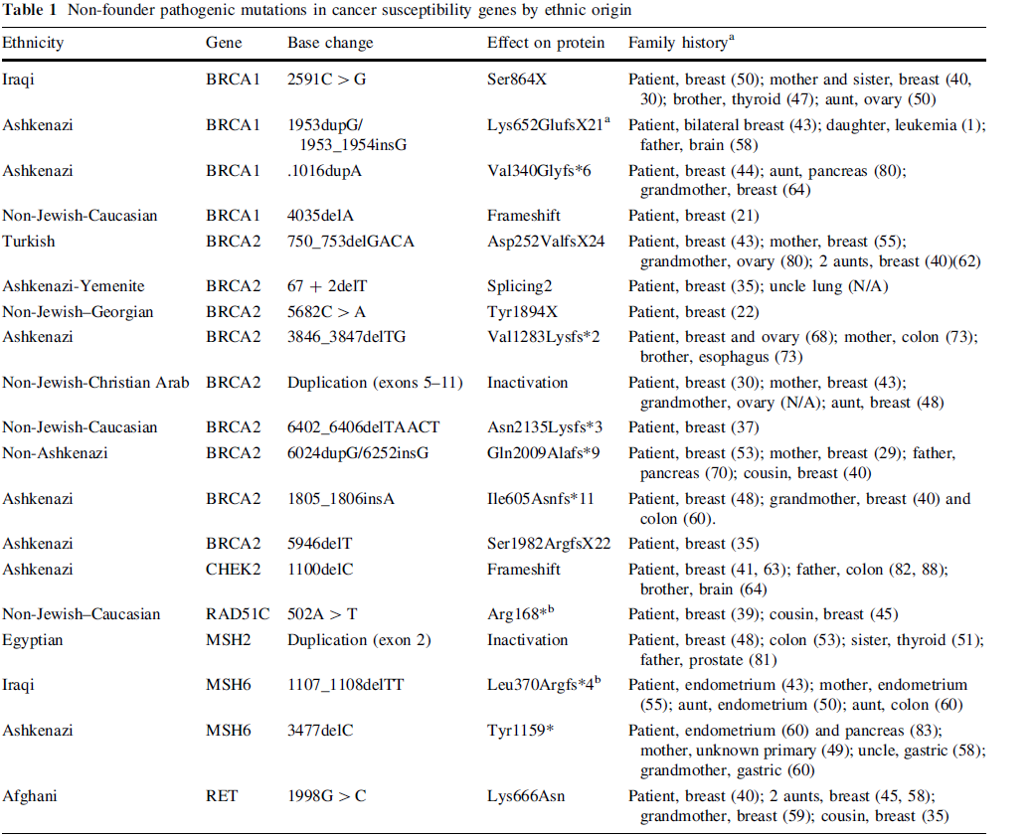
Yablonski-Peretz et al, Breast Cancer Res Treat, 2016, 155, 133-38

Slide 8
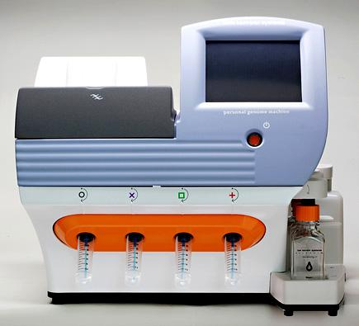
Germline mutation panel
Ion PGM™ Sequencer
Custom germline panel -
Number of bases – 107,871
Number of genes – 22 (Overall Coverage)
ATM (95.9%), BARD1 (100%), BRCA1 (99.8%), BRCA2 (95.3%), BRIP1 (95.8%), CDH1 (100%), CDKN2A (100%), CHEK2 (91.4%), MLH1 (100%), MRE11A (96.2%), MSH2 (98.6%), MSH6 (99.2%), MUTYH (100%), NBN (99.9%), NLRP2 (100%), PALB2 (98.6%), PMS1 (89.5%), PMS2 (79.8%), PTEN (98.6%), RAD50 (93.9%), RAD51C (95.2%), STK11 (100%), TP53 (96.6%)

Slide 9
Validation
Patient population: 63 patients from the onco-genetic clinic in Hadassah Medical Center that have signed an informed consent that harbor known mutations in the BRCA1, BRCA2, MLH1 and PMS2 genes were tested and the mutations were identified. In 2 samples with low coverage the mutations were not identified.

Slide 10
Clinical trial HMO 0346-12
Characterization of genetic material, including total genome/exome sequencing from tumor cells as a predictive and prognostic measure, and as a tool to follow up treatment in cancer patients.

Slide 11
Is part of Midgam.
As of 2-23 more than 12,500 participants.
Demographic, ICD-0 (tumor site and tumor morphology), cytotoxic treatments are automatically retrieved from the Hadassah medical center.
About 3500 blood and 6400 plasma samples available. For many cancer patients tissue is available, for some with molecular data.
Anonymized approach to the data is available through the Hadassah REDCAP.

Slide 12
Recurrent TP53 Missense Mutation in Cancer Patients of Arab Descent Population: We evaluated five breast cancer patients of Arab descent diagnosed with cancer before the age of 50 years and identified the previously described TP53 mutation, c.541C>T, R181C (rs587782596), in two women from unrelated Arab families. We further tested 85 unrelated Arab cancer patients and father of a BC carrier patient for TP53 c.541C>T using a real time polymerase chain reaction (RT-PCR) approach and identified four additional carriers, two with BC one with lung cancer, and the father of a BC carrier patient, diagnosed with GBM.

Slide 13
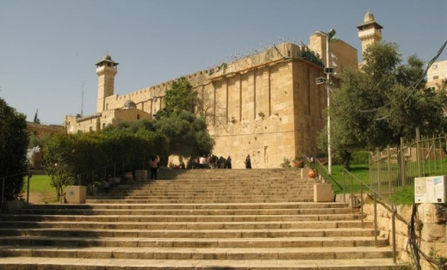
Zick et al, Recurrent TP53 Missense Mutation in Cancer Patients of Arab Descent, Fam Can, 2016, Apr;16(2):295-301

Slide 14
N (%) | Characteristic
36 (19-66) | Median age (Range)
13 (59) 9 (41) | Gender Male Female
15 (68) 3 (14) 4 (18) | Familial origin Kurdistan Jerusalem Area Other
18 (81) | Positive family history
3 (14) 4 (18) 4 (18) | Co-Morbidities Smoking BMI > 30 Hypertension and Diabetes
17 (77) 5 (23) | Stage at diagnosis Local disease Metastatic
Arnon et al, unpublished

Slide 15
Cancer type
Arnon et al, unpublished

Slide 16
Arnon et al, unpublished

Slide 17
“TP53 R181C is responsible for 15% of breast cancer in familial and young Palestinian patients. This mutation therefore has a substantial impact on breast cancer incidence among Palestinian women. On the other hand, penetrance is clearly incomplete, both in the families in this study and those reported previously. Too few families have yet been evaluated to have a robust estimate of risk, but those studied so far suggest that breast cancer risk by age 60 among carriers of this mutation may be between 50 and 75%.”
Hamameh et al, Int. J. Cancer: 141, 750–756 (2017)
“None of the 26 Muslim individuals genotyped herein was a carrier of any TP53 mutation, nor did we find the p. R181C*TP53 mutation when genotyping a set of 87 unrelated Muslim BC cases or in 245 cancer-free ethnically matched controls (Friedman E: unpublished data).”
Zidan et al, Breast Cancer Res Treat: (2017),e-published

Slide 18
In Hadassom
Among all Muslim Arabs 0.36% are carriers with allele frequency of 0.18%.
Among all Muslim Arabs living in the Jerusalem area 0.74% are carriers with allele frequency of 0.37%.
As of 3-23 the Hadssom contains exome sequencing of more than 15,400 people, about a third are Arab Muslims. About a third of Arab Muslims live in the Jerusalem area.

Slide 19
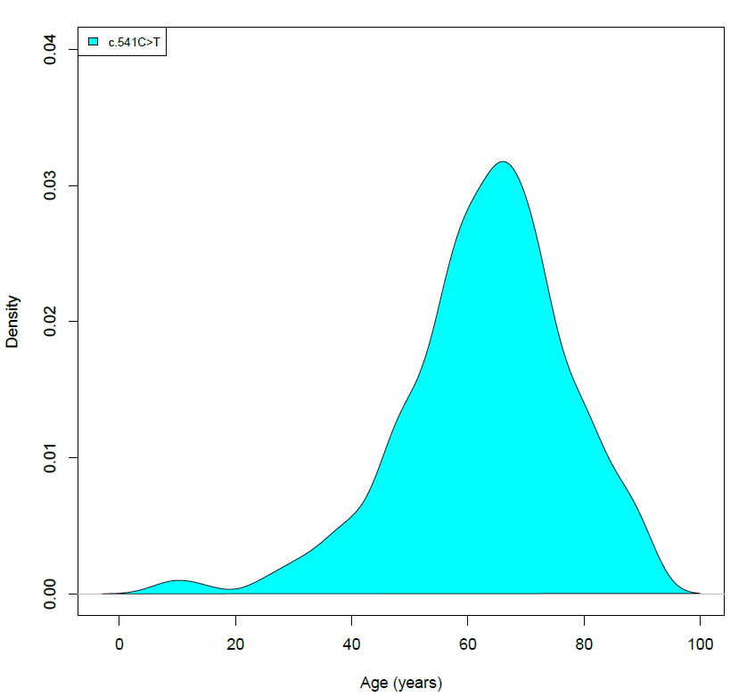
Foundation One data
There a 680,473 cancer patients that performed a FoundationOne test.
Of them 348 of the samples have a TP53 c.541C>T mutations
And 1545 of the samples have a founder BRCA2 mutations.
TP53 c.541C>T
BRCA2
0
20
40
60
80
100
0
20
40
60
80
100
Age (years)

Slide 20
TP53 c.541C>T
BRCA2
EUR
AFR
EAS
AMR
SAS
EUR
EAS
AFR
AMR
Predicted ancestry

Slide 21
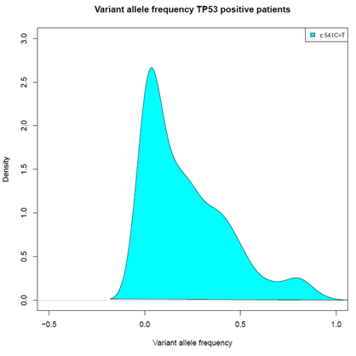
TP53 c.541C>T
BRCA2
0
0.5
1
0
0.2
0.4
0.6
0.8
1
Variant allele frequency

Slide 22
***
***
***
***
***
***
***
***
***

Slide 23
TP53 R181C
Gorina & Paveletich, Science, 1996, 274, 1001-1004
Samuels-Lev et al, Mol Cell, 2001, 8, 781-794

Slide 24
TP53 R181C mouse model
Kang et al, Cell Rep. 2020 Jan 21;30(3):783-792.

Slide 25
Kang et al, Cell Rep. 2020 Jan 21;30(3):783-792.

Slide 26
Kang et al, Cell Rep. 2020 Jan 21;30(3):783-792.

Slide 27
Kang et al, Cell Rep. 2020 Jan 21;30(3):783-792.

Slide 28
Kang et al, Cell Rep. 2020 Jan 21;30(3):783-792.

Slide 29
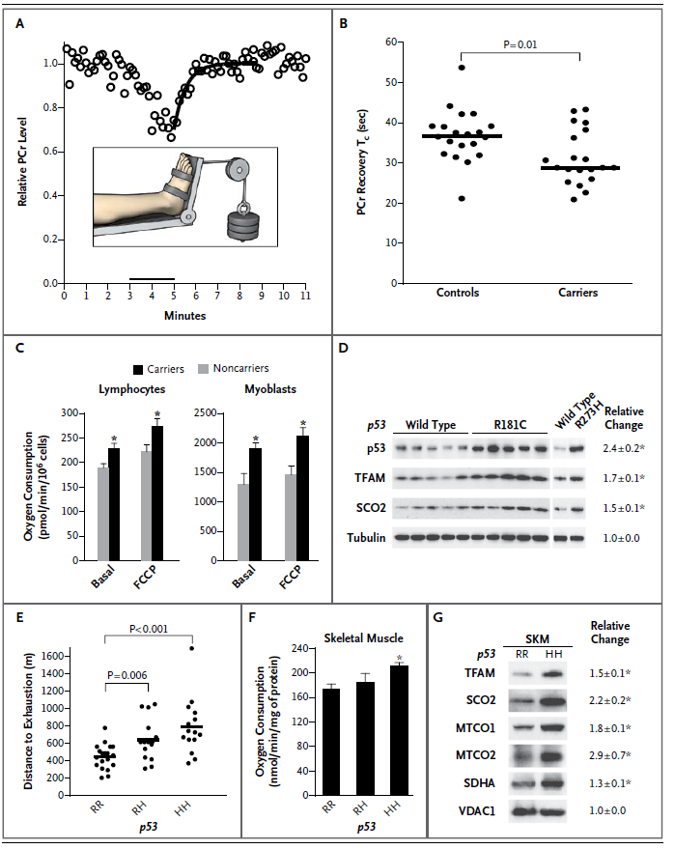
TP53 R181C
Wang et al, NEJM, 2013, 368, 1027-32

Slide 30
Mutational signature
Alexandrov et al, Nature, 2013, 502, 415-421

Slide 31
Alexandrov et al, Nature, 2013, 502, 415-421

Slide 32
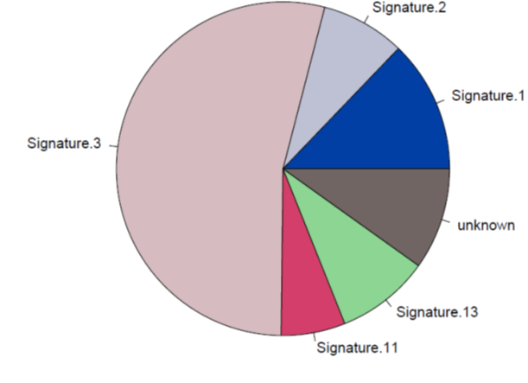
Molecular signature in a BRCA mutated cell line
Etiology of Mutational Signature Based on COSMIC
Signature 1 mutations correlates with age of cancer diagnosis.
Signature 2/13 has been attributed to activity of the AID/APOBEC family of cytidine deaminases.
Signature 3 is strongly associated with germline and somatic BRCA1 and BRCA2 mutations.
Signature 11 exhibits a mutational pattern resembling that of alkylating agents.

Slide 33
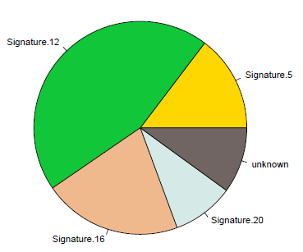
Molecular signature in a TP53 R181C tumor
Etiology of Mutational Signature Based on COSMIC
The aetiology of Signature 5 is unknown.
The aetiology of Signature 12 remains unknown.
The aetiology of Signature 16 remains unknown.
Signature 20 is believed to be associated with defective DNA mismatch repair.

Slide 34
Conclusion
We suggest pre-screening for TP53 c.541C>T in Muslim Arabs living in the Jerusalem area.
Deriving pathogenic variations from somatic data depends on mutation and population

Slide 35
Characterization of mutational signature as tool for understanding some aspects of TP53 R181C mutated tumor biology. Studying the physiology of TP53 R181C carriers.
Future plans

Slide 36
Thank you very much

