Slide 1
Introduction - The role of the molecular biologist in the molecular tumor board
Aviad Zick, M.D., Ph.D. Sharett Institute of Oncology
Hadassah Medical Center
E-mail – aviadz@hadassah.org.il
Phone – 050-4048024

Slide 2
Topics
What is cancer?
What is a molecular test?
What is a molecular tumor board?
What are the public data bases that can be used to interpret a molecular test and give relevant recommendations to a patient?

Slide 3
What is cancer?
Cancer is a class of disease where the cells of an organ grow to form a mass and at advance stages spread to other organs. The dogma of cancer is that the etiology of cancer is an aberration at the molecular level typified by an unknown mix of DNA mutations, immunological modulation and other tissue specific factors.

Slide 4
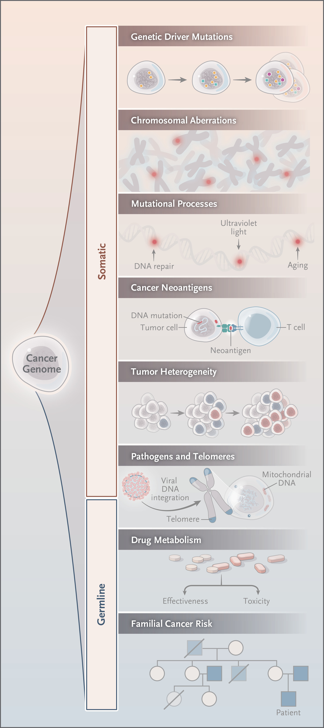
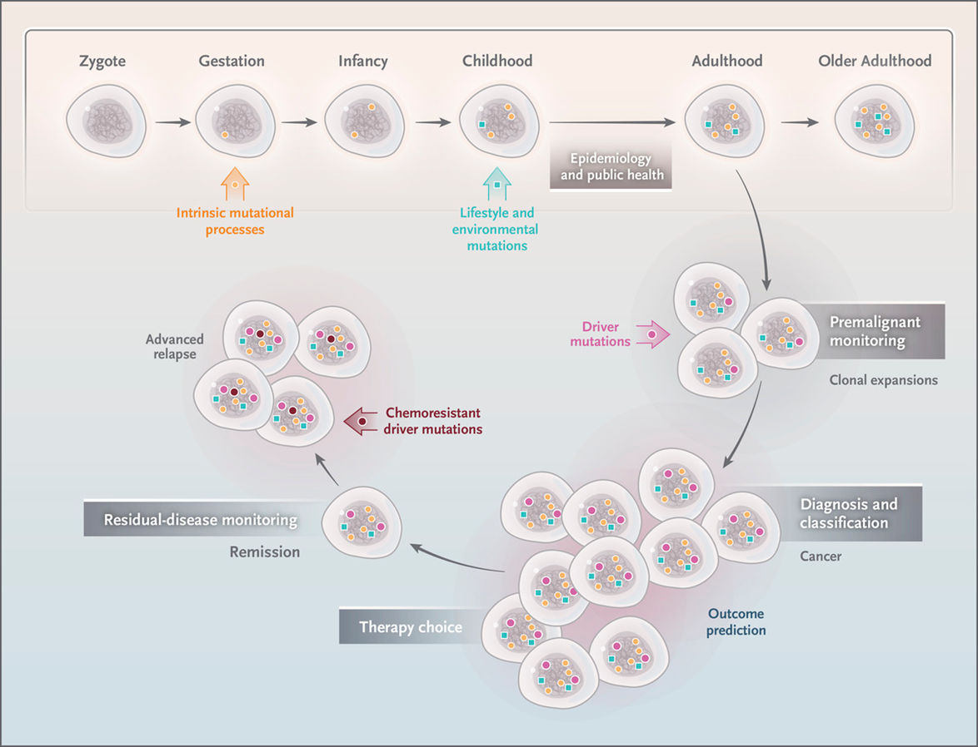
Insights and opportunities from Studying the Cancer Genome.
J Nangalia, PJ Campbell. N Engl J Med 2019;381:2145-2156.
Notes:
Figure 1. Insights from Studying the Cancer Genome. Sequencing a patient’s cancer provides insights into many facets of tumor biology. These include features acquired as somatic alterations by the cancer clone, such as driver mutations, large-scale chromosomal abnormalities, and mutations recognized by the immune system (neoantigens). In addition, inherited factors can also be assessed, such as familial cancer risk and variants affecting the metabolism of therapeutic agents used to treat cancers.

Slide 5
What is a molecular test?
A molecular test is a method to interrogate the molecular components of a tissue.
DNA – Sequence (point mutations, copy number alterations, translocation), methylation, aberrant nucleotides.
RNA – Amount, splice variant
Protein – Expression, glycosylation, modification.
Metabolism – Amount and Type
Other organisms – Amount and Type

Slide 6
What are the public data bases that can be used to interpret a molecular test and give relevant recommendations to a patient?
Oncological data base –
NCCN - https://www.nccn.org/ one time login
Clinical trials data base – https://clinicaltrials.gov/
DNA – Sequence
For point mutations - https://cancer.sanger.ac.uk/cosmic
For genome browser - https://genome.ucsc.edu/cgi-bin/hgGateway
For what a gene does - https://www.ncbi.nlm.nih.gov/gene/?term=EGFR

Slide 7
What is a molecular tumor board?
A meeting where oncologist, pathologists, geneticist, surgeons and biologist plan treatment for a cancer patient based on -
Demographics – Age, Sex
Exposure – Environmental
Clinical history – Previous disease, current disease, treatment
Known standard of care practice – Guidelines, clinical trials.
Molecular tests analysis – DNA, RNA, Protein any other

Slide 8
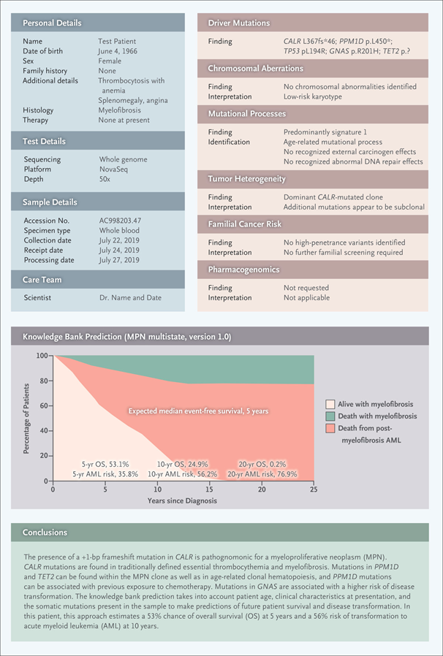
Cancer genomic report
J Nangalia, PJ Campbell. N Engl J Med 2019;381:2145-2156.
Notes:
Figure 1. Insights from Studying the Cancer Genome. Sequencing a patient’s cancer provides insights into many facets of tumor biology. These include features acquired as somatic alterations by the cancer clone, such as driver mutations, large-scale chromosomal abnormalities, and mutations recognized by the immune system (neoantigens). In addition, inherited factors can also be assessed, such as familial cancer risk and variants affecting the metabolism of therapeutic agents used to treat cancers.

Slide 9
Insights from Studying the Cancer Genome.
Thank you!

