Slide 1
The utility of REDCap and Cbioportal in collecting and analyzing oncological patient’s clinical data
Aviad Zick, M.D., Ph.D. Sharett Institute of Oncology
Hadassah Medical Center
E-mail – aviadz@hadassah.org.il
Phone – 050-4048024
REDCap as a research enabler, 4-Jun-2023

Slide 2
Thank you
Sharett institute of Oncology staff; Tamar Hamburger
Pathology department staff;
Hadas - Onco-genetic clinic staff;
Neurooncology laboratory – Iris Lavon, Aviel Iluz;
Hadassah medical center.
Myriam Maoz, Sherri Cohen, Michal Inbar, Mazal Tov Marouani, Idit Amir, Michal Dvir, Dana Sherill-Rofe
Yuval Tabach group, Dolev Rahat,
Yuval Dor Group
Ittai Ben-Porath
Amir Eden
Rotem Karni
Ben Berman
Nir Fridman
Efrat Shema
Tommy Kaplan
Supported by Sharett institute fund; ISF, ICRF, The Joint Research Fund between the Hebrew University Faculty of Medicine, and between Hadassah University Hospital, Shaare Tzedek Medical Center, Kaplan Medical Center and Bikur Holim Hospital,
Grants - MERCK, Karyopharm & Roche; Consultation - IMEL Biotherapeutics
Notes:
2

Slide 3
What kind of data do we want for our research?
Demographic (Age, Sex, Martial statues, number of children, address)
Oncological Diagnosis
Medical history
Treatment (Surgical, Radiotherapy, Medical)
Molecular findings (pathogenic variations,
Immunohistochemistry, somatic variations, expression data)
Research data

Slide 4
Statues
Machar – The work environment of the Hadassah Medical center. Contains electronic medical records spanning 40 years. Some fields are tabulated but most of the information is in free text. One person at a time one patient at a time.
TriNetX – An interface allowing anonymized data interrogation for some fields. One person at a time.

Slide 5
Aim
A graphical interphase that automatically captures data from the Machar and research, allows entry of new fields, multiple users can work simultaneously, easy to use.

Slide 6
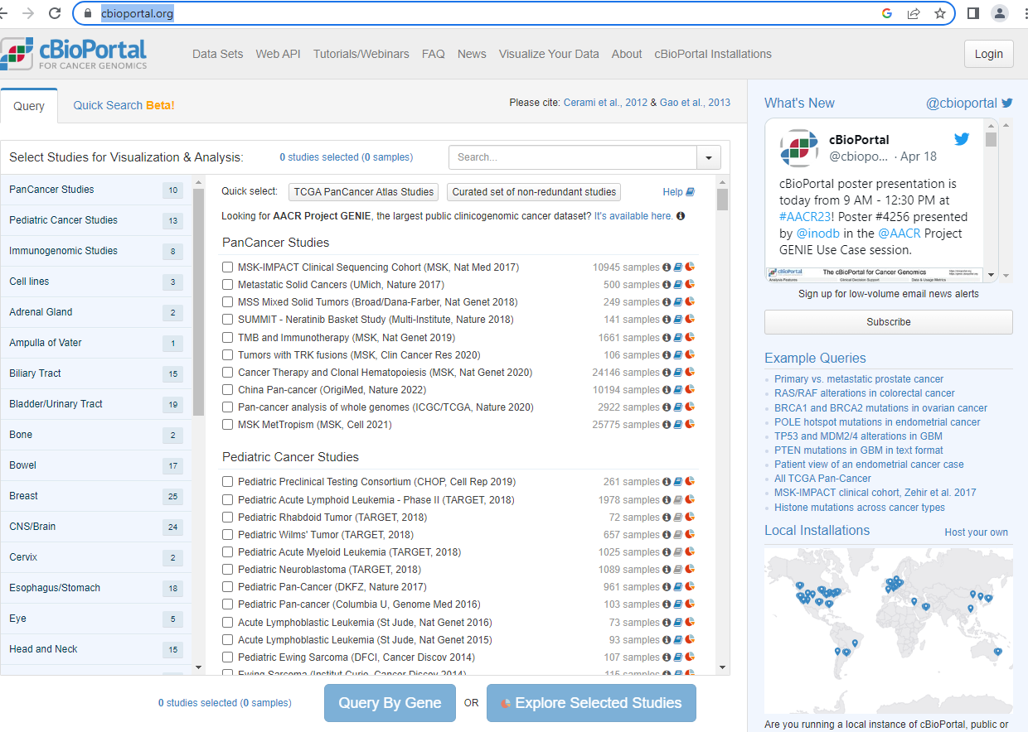
cBioportal
https://www.cbioportal.org/

Slide 7
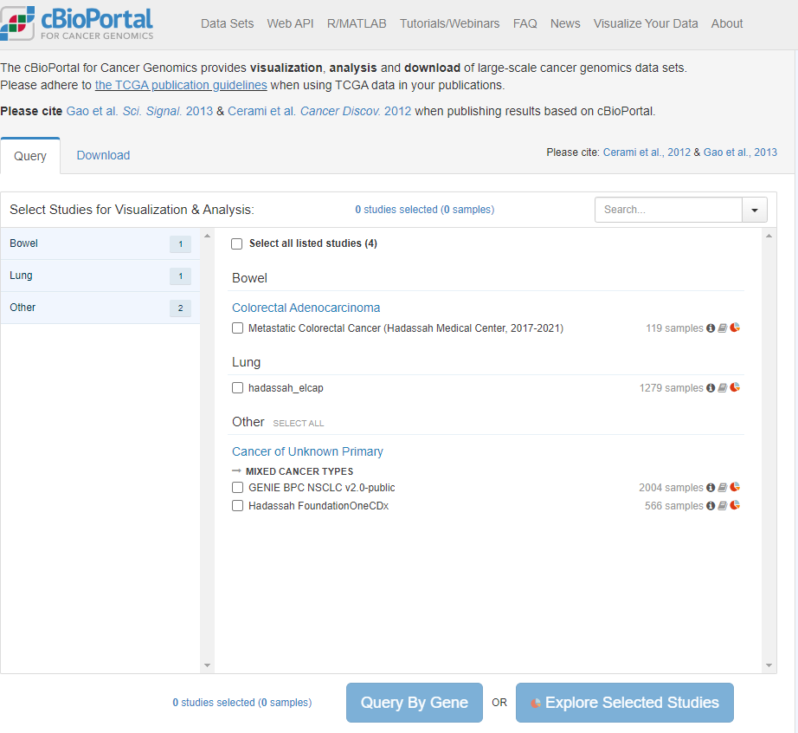

Slide 8
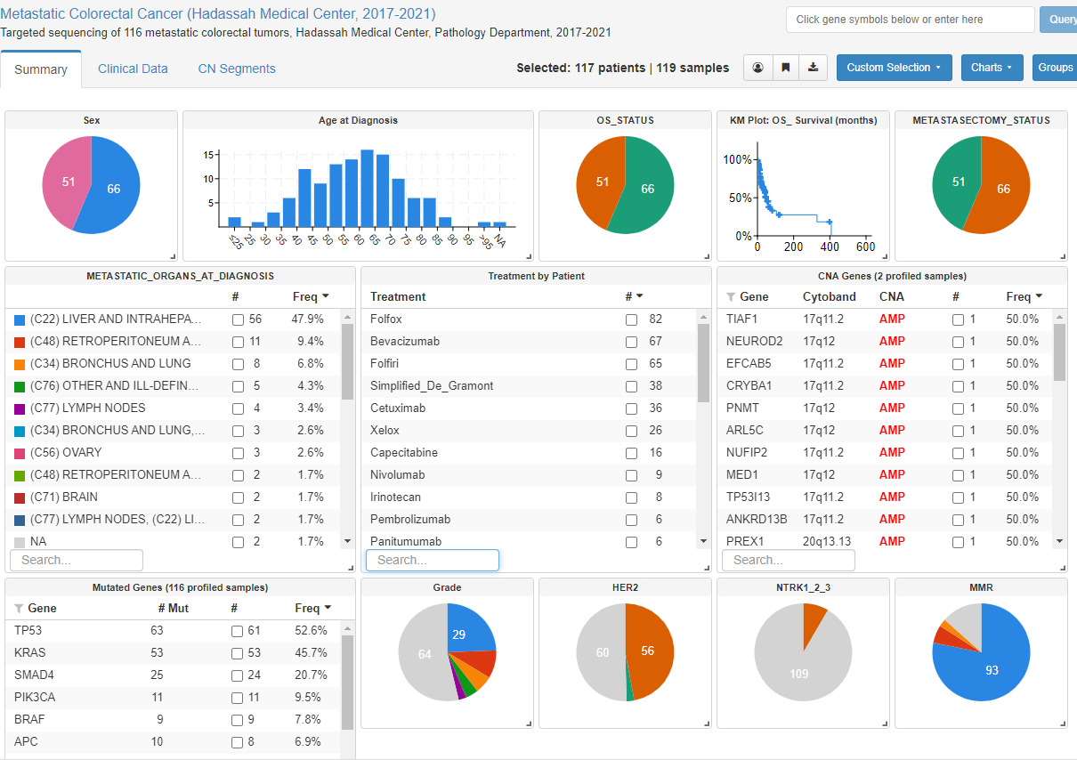

Slide 10
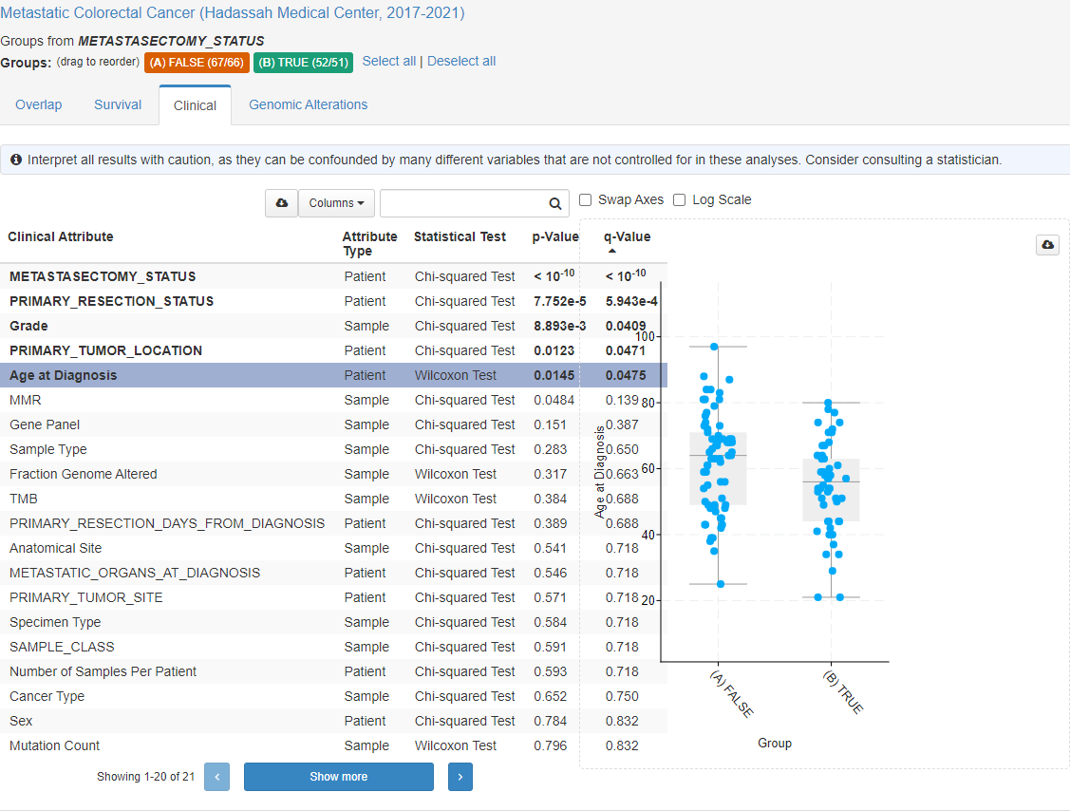

Slide 11
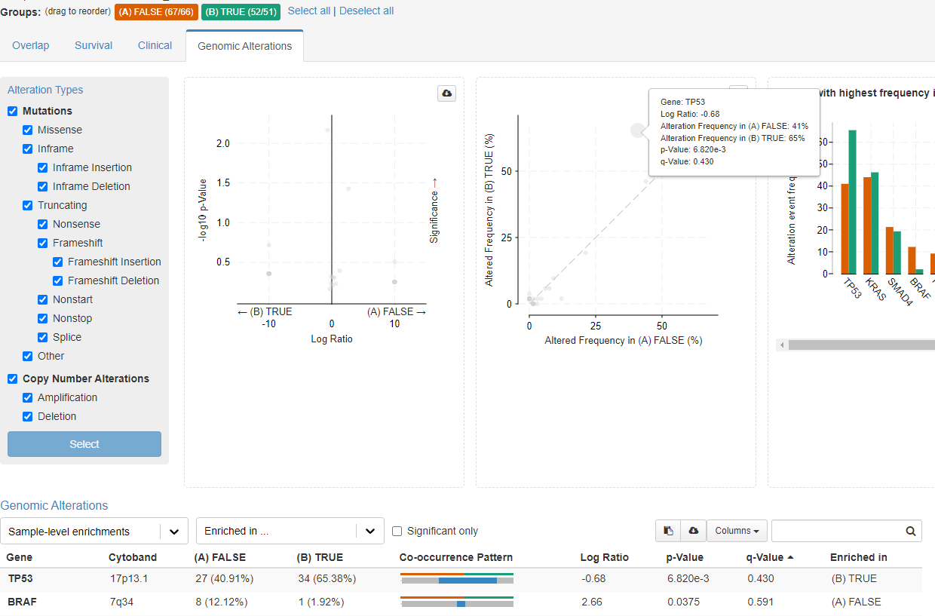

Slide 12
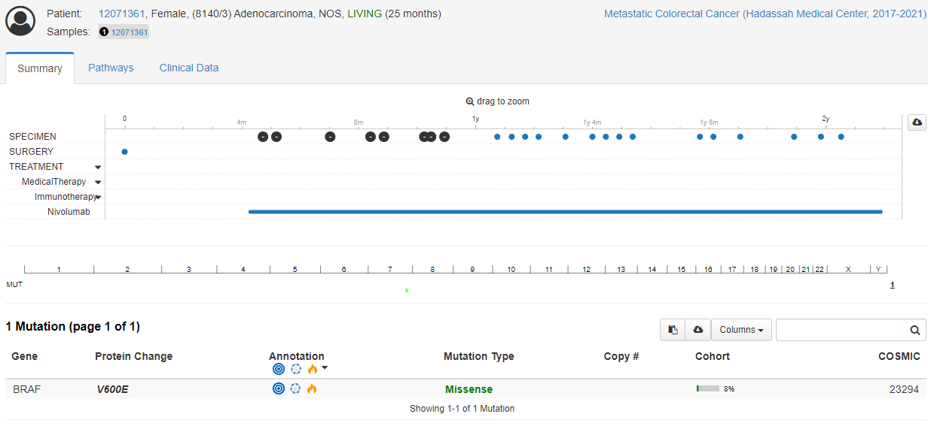

Slide 13
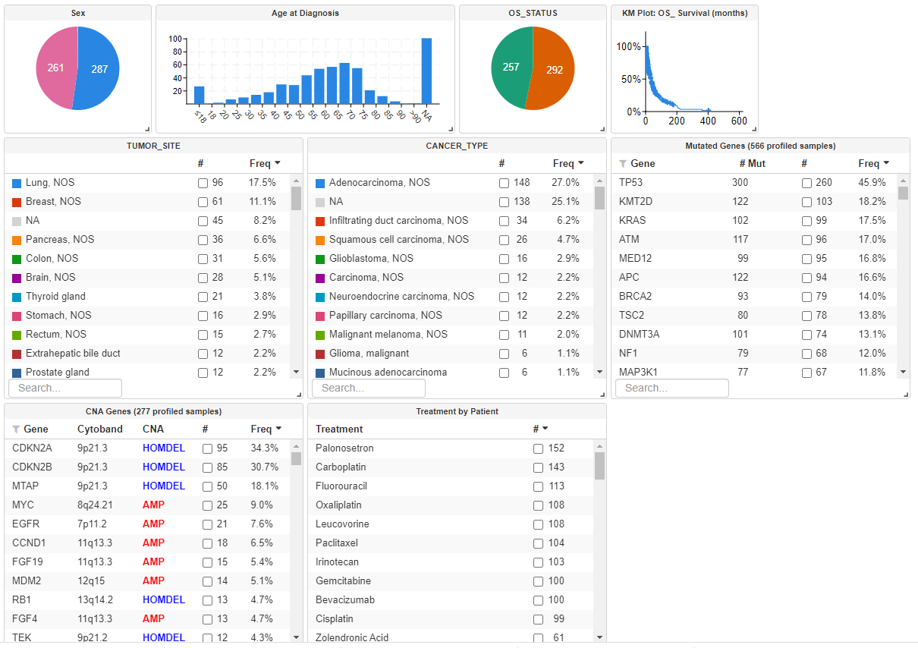

Slide 14
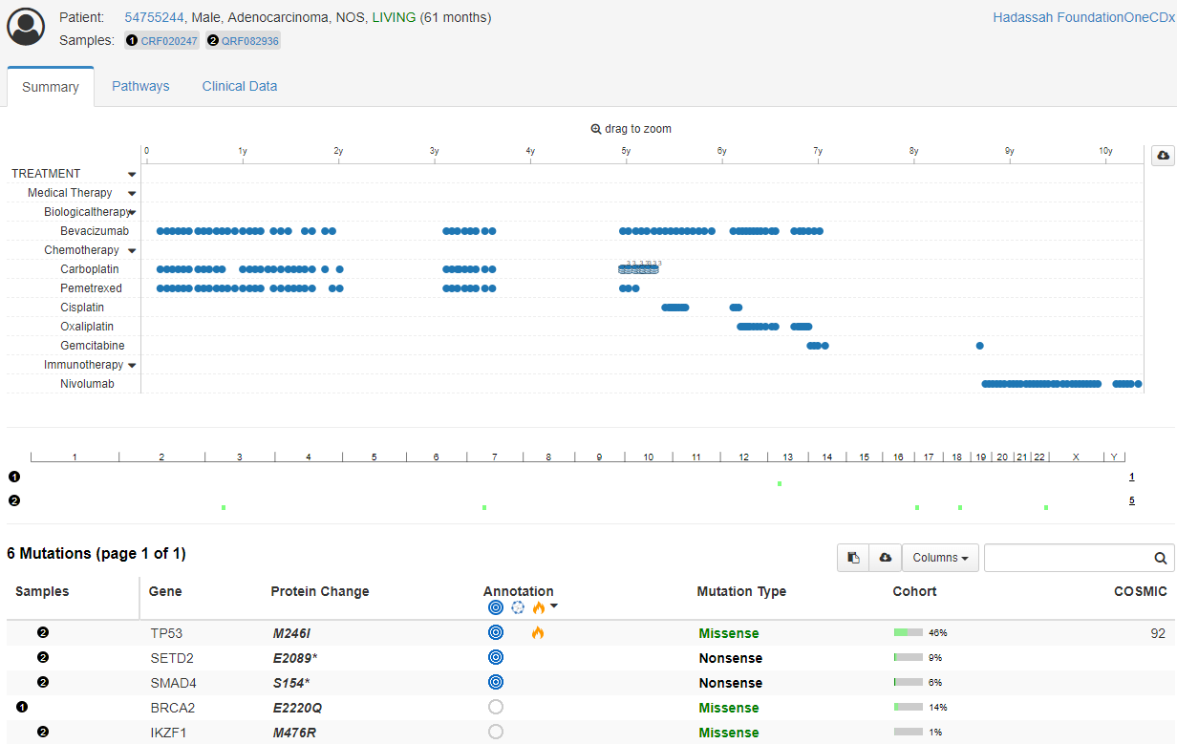

Slide 15
REDCap

Slide 16
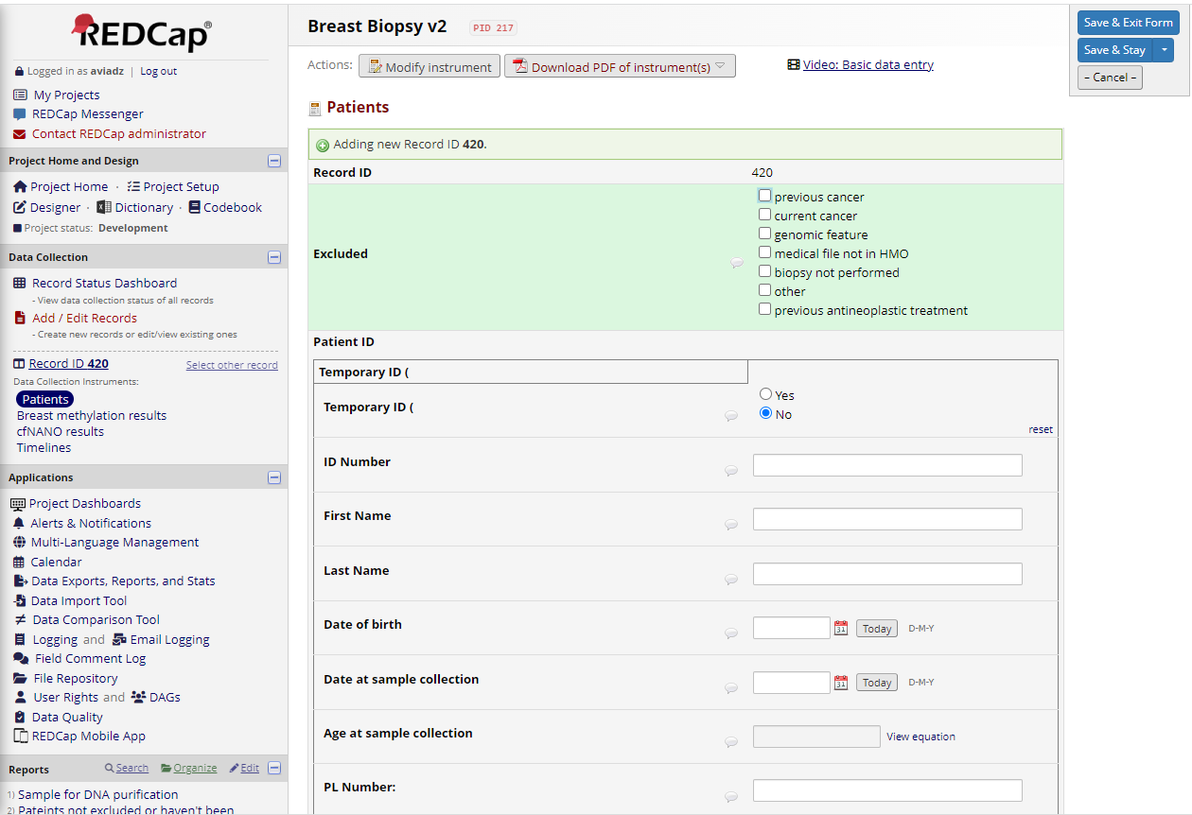

Slide 17
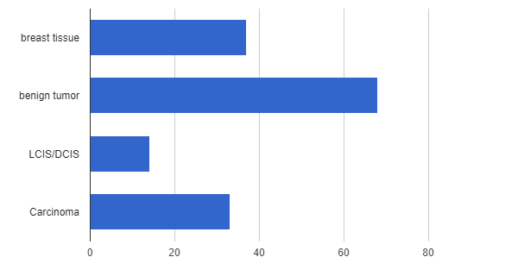

Slide 23
Conclusion and plans
REDCap and Cbioportal are part of routine research and entering clinical care.
Much more work is needed to add various aspects to the platforms.
Integration across different medical and research disiplinaries

Slide 24
Thank you!

