Slide 1
Clinical Case #2
94300 Implementing Molecular Findings to Oncological Patients' Care
Widad Samman

Slide 2
01
About the Patient

Slide 3
Patient Medical History
Age: 72
Gender: female
Habits: non-smoker
11/2022
Referred to the head and neck surgery of the Hadassah medical center due to hoarseness and hemoptysis
Notes:
Hemoptysis is when you cough blood that comes from the lungs

Slide 4
Imaging
Liver
Lung
Brain
Notes:
On imaging lung, liver and brain lesions

Slide 5
Results
In 11/2022,
A mediastinal biopsy was performed on pathology non-small cell carcinoma, favoring adenocarcinoma of lung origin

Slide 6
Lung Cancer
Evolution
Prevalence
85%
Non-small cell lung cancer
Adenocarcinoma
15%
Small cell lung cancer
Squamous cell carcinoma
2,200,000
In 2020
Large cell carcinoma
Notes:
Lung cancer is the 2nd most common cancer worldwide. It is the most common cancer in men and the 2nd most common cancer in women.
There were more than 2.2 million new cases world-wide of lung cancer in 2020.
Adenocarcinoma usually begins in the outer areas of the lung, in mucus-producing cells that line the small airways, called bronchioles. Adenocarcinoma tends to grow more slowly than other types of lung cancer, which can help lead to a better prognosis.
https://www.wcrf.org/cancer-trends/lung-cancer-statistics/
Lung cancer is the most common cancer with the highest mortality rate. Non-small cell lung cancer (NSCLC) accounts for about 80% of lung cancer. Because of its high malignancy and rapid development, 70–80% of NSCLC patients are inoperable when diagnosed, and comprehensive treatment based primarily on systemic treatment is often required
https://www.ncbi.nlm.nih.gov/pmc/articles/PMC7661875/

Slide 7
Treatment

Slide 8
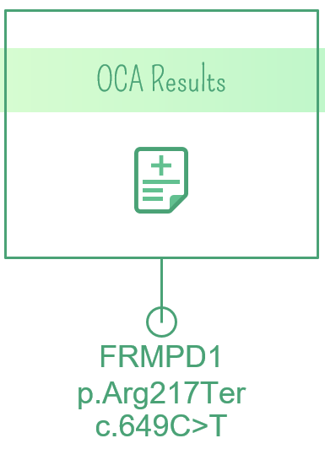
Treatment
12/2022-
02/2023
Pemetrexed in combination with carboplatin, nivolumab and ipilimumab
02/2023-
04/2023
Nivolumab in combination with ipilimumab
Notes:
R217
https://www.proteinatlas.org/ENSG00000070601-FRMPD1/pathology/lung+cancer#Quantity

Slide 9
Diagnosis and prognosis
Stage IV non-small cell cancer (Adenocarcinoma) with brain and liver metastasis.
2-7% chance of surviving for 5 years
Notes:
Unfortunately, since it is stage 4, the medication that is given is not given to cure her but it is given to alleviate her symptoms and to increase her quality of life and give her more time

Slide 10
Pemetrexed
Nivolumab
Carboplatin
Ipilimumab
Notes:
Let’s talk a little bit about the medications that she was given, starting with pemetrexed, which is a chemotherapy that is given as a first treatment to advanced or metastatic NSCLC either on its own or in combination with either cisplatin, carboplatin or pembrolizumab. It’s an anti metabolite that stops cancer cells from making and repairing DNA so that they can’t grow or multiply.
Carboplatin is also a chemotherapy that is used for many types of cancers to reduce tumor growth, it’s a platinum agent that that has the same therapeutic effect as cisplatin but has fewer adverse events even though cisplatin has a consistent survival advantage, it carries a higher toxicity profile, including nausea, vomiting, neuropathy, renal insufficiency, and alopecia in comparison to carboplatin. When the goal of therapy is curative, the survival benefits with cisplatin are in most circumstances worth the increased toxicities. When the goal of therapy is palliation, the relative price of toxicity needs to be weighed on the basis of the individual patient in an effort to maximize quality of life.
Nivolumab, is the first antibody that acts as a PD-1 inhibitor, meaning it blocks PD-1 from binding to its ligands PDL1/2 and promotes antitumor immunity, and it is effective for treating non-small-cell lung cancer (NSCLC) and restores the function of existing anti-tumour T cells.
And finally, ipilimumab, which is usually used in combination with nivolumab and 2 cycles of platinum-doublet chemotherapy. It is usually used as a first-line treatment for adult patients with metastatic or recurrent non-small cell lung cancer (NSCLC) with no EGFR or ALK genomic tumor. This immunotherapy drug has the ability to bind to the protein CTLA-4, which is a receptor that normally functions to inhibit prolonged T cell activity; therefore this drug activates immune cells and allows them to kill cancer cells specifically, it induces T-cell proliferation and de-novo anti-tumour T-cell responses, including in memory T cells.
What was interesting to me was why they used an immunotherapy drug that inhibited PD1 when the patient was PDL1 negative. There was a trial that andomly assigned patients with stage IV or recurrent NSCLC and a PD-L1 expression level of 1% or more to receive nivolumab plus ipilimumab, nivolumab alone, or chemotherapy. The patients who had a PD-L1 expression level of less than 1% were randomly assigned o receive nivolumab plus ipilimumab, nivolumab plus chemotherapy, or chemotherapy alone. The study showed that First-line treatment with nivolumab plus ipilimumab resulted in a longer duration of overall survival than did chemotherapy in patients with NSCLC, independent of the PD-L1 expression level. And according to NCCN this is the standard treatment for patients with advanced NSCLC
Why they give anti PDL1 if she was PDL1 negative: https://www.nejm.org/doi/full/10.1056/nejmoa1910231
First-line treatment with nivolumab plus ipilimumab resulted in a longer duration of overall survival than did chemotherapy in patients with NSCLC, independent of the PD-L1 expression level
PEMETREXED- A chemotherapy that is given to NSCLC it’s usually given on its own or in combination with other cancer drugs like cisplatin, or carboplatin or pembrolizumab. Pemetrexed is a type of drug known as an anti-metabolite. It stops cancer cells from making and repairing DNA so they can't grow and multiply. Given once every 3 weeks
https://www.cancerresearchuk.org/about-cancer/treatment/drugs/pemetrexed#:~:text=Pemetrexed%20is%20a%20type%20of,small%20cell%20lung%20cancer%20(NSCLC) https://www.ncbi.nlm.nih.gov/pmc/articles/PMC7661875/
* Peme-Sol 25mg/ml in combination with cisplatin is indicated for the treatment of patients with malignant pleural mesothelioma whose disease is unresectable or who are otherwise not candidates for curatible surgery. Peme-Sol 25mg/ml in combination with cisplatin is indicated for the first line treatment of patients with locally advanced or metastatic non-small cell lung cancer other than predominantly squamous cell histology. Peme-Sol 25mg/ml is indicated as monotherapy for the second line treatment of patients with locally advanced or metastatic non-small cell lung cancer other than predominantly squamous cell histology. Peme-Sol 25mg/ml is indicated as monotherapy for the maintenance treatment of locally advanced or metastatic non-small cell lung cancer other than predominantly squamous cell histology in patients whose disease has not progressed immediately following platinum-based chemotherapy.
Carboplatin-
Advanced ovarian carcinoma in initial treatment and secondary treatment.Metastatic small cell carcinoma of the lung.
https://pubmed.ncbi.nlm.nih.gov/19225891/#:~:text=Meta%2Danalyses%20of%20palliative%20chemotherapy,alopecia%20in%20comparison%20to%20carboplatin. (carboplatin vs cisplatin)
Nivolumab- a fully human immunoglobulin G4 PD-1 immune checkpoint inhibitor antibody, blocks PD-1 and promotes antitumor immunity, and it is effective for treating non-small-cell lung cancer (NSCLC), melanoma, renal cell carcinoma (RCC) and other cancers.
Non-Small Cell Lung Cancer:- Opdivo, in combination with ipilimumab and 2 cycles of platinum-doublet chemotherapy, is indicated for the first-line treatment of adult patients with metastatic or recurrent non-small cell lung cancer (NSCLC), with no EGFR or ALK genomic tumor aberrations.- Opdivo is indicated for the treatment of patients with metastatic non small cell lung cancer (NSCLC) with progression on or after platinum-based chemotherapy. Neoadjuvant Treatment of Resectable Non-Small Cell Lung Cancer:OPDIVO, in combination with platinum-doublet chemotherapy, is indicated as neoadjuvant treatment of adult patients with resectable (tumors ≥4 cm or node positive) non-small cell lung cancer (NSCLC).
https://www.ncbi.nlm.nih.gov/pmc/articles/PMC5332892/#:~:text=Nivolumab%2C%20a%20fully%20human%20immunoglobulin,(RCC)%20and%20other%20cancers.
Ipilimumab-
Metastatic Non-Small Cell Lung CancerYERVOY, in combination with nivolumab and 2 cycles of platinum-doublet chemotherapy, is indicated for the first-line treatment of adult patients with metastatic or recurrent non-small cell lung cancer (NSCLC) with no EGFR or ALK genomic tumor aberrations.
https://www.cancer.gov/publications/dictionaries/cancer-terms/def/ipilimumab
https://www.ncbi.nlm.nih.gov/books/NBK557795/

Slide 11
FRMPD1
Establishment of protein localization to membrane
Regulation of G protein-coupled receptor signalling pathway
Notes:
FRMPD1 stands for FERM and PDZ domain containing 1, the FERM domain allows it to bind to the cytoplasm and the PDZ domain allows it to interact with other proteins. Protein-protein interactions play a vital role in biological functions. This protein’s function is not yet known, however there are articles that suspect its role in different pathway. In general however, it is thought to be involved in establishment of protein localization to membrane and regulation of G protein-coupled receptor signalling pathway.

Slide 12
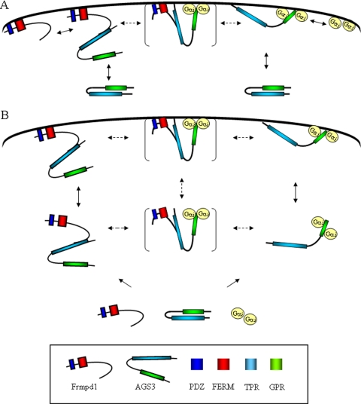
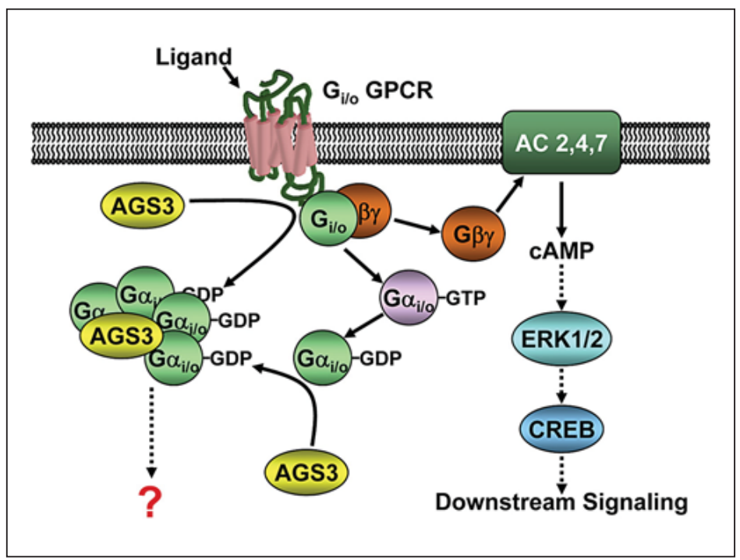
FRMPD1
(An et al. 2008)
(Tse and Wong 2012)
Notes:
There are other articles that reported the identification of Frmpd1 as a regulatory binding partner of AGS3, which is a member of the G protein signaling (AGS) family, that activates the G protein. Frmpd1 binds to the TPR domain of AGS3. This is how they illustrated the interaction between the two proteins. AGS3 in the cytosol may position itself at the cell cortex via interaction with membrane-bound Frmpd1 or it may find the protein in another cellular compartment and the complex would move to the cell cortex. Once in the cortex, AGS3 can detach and bind to other proteins

Slide 13
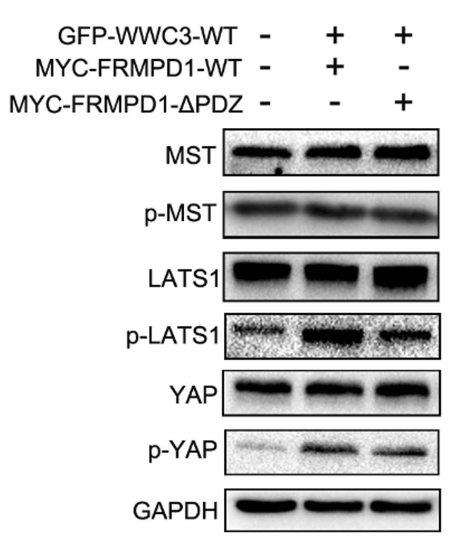
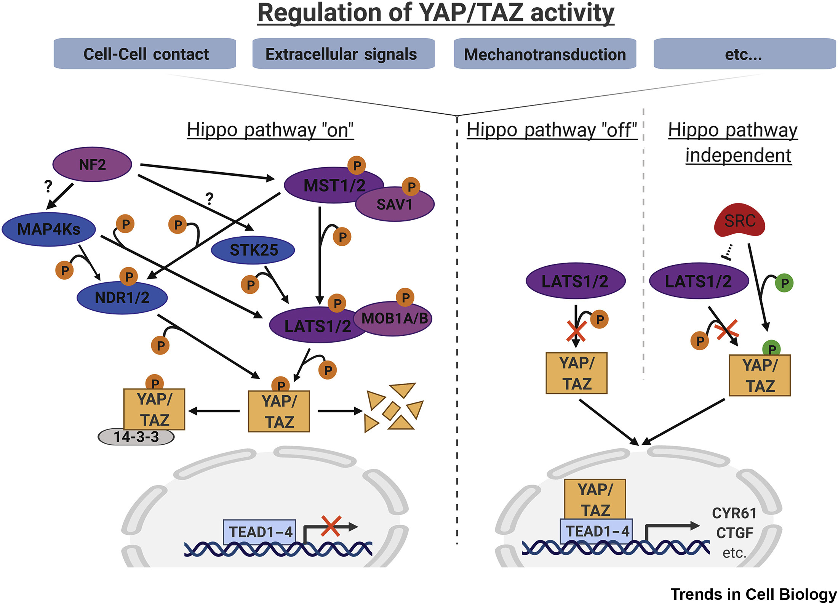
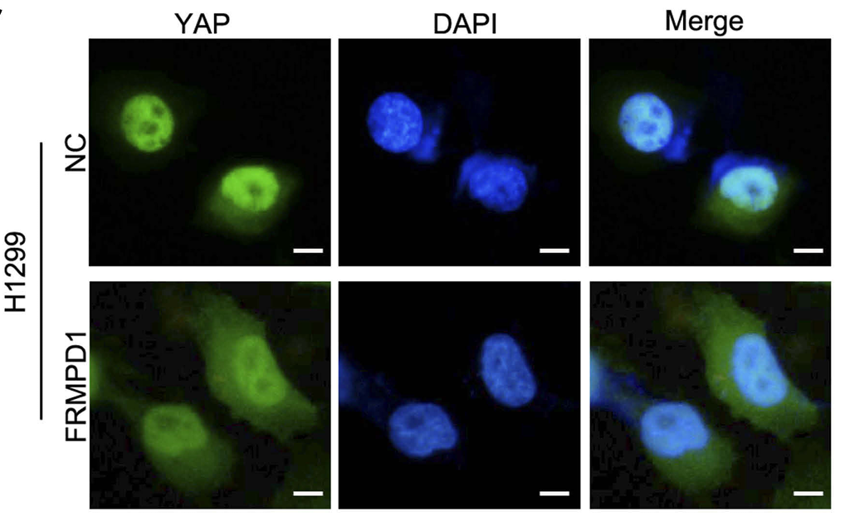
FRMPD1
(Rong et al. 2019)
(Rausch and Hansen 2020)
Notes:
There are papers that showed that FRMPD1 is connected to the Hippo pathway. Since they were able to show that FRMPD1 significantly enhanced the phosphorylation of LATS1 and YAP when wild-type FRMPD1 and wild-type WWC3 were co-transfected, and their phosphorylation wasn’t notably increased when mutant FRMPD1 was transfected. They also showed that transfection of FRMPD1 into H1299 cells leads to a decrease in the nuclear translocation of YAP and the transcriptional activity of the target gene. Moreover, FRMPD1 was confirmed to be a positive regulator of the Hippo pathway. https://www.ncbi.nlm.nih.gov/pmc/articles/PMC6497479/

Slide 14
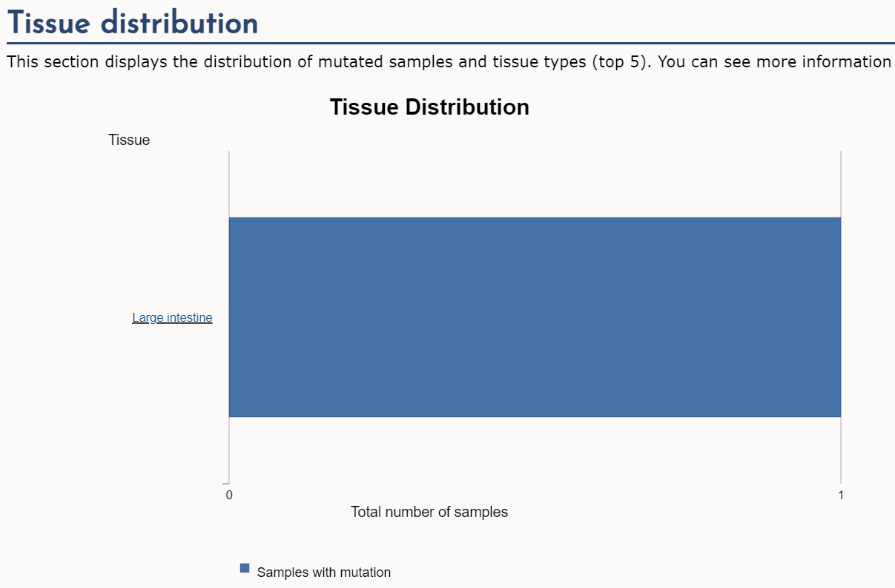
Mutated FRMPD1
(Cosmic n.d.)
Notes:
As for the mutation that the patient had, it is a non-sense mutation, which is a change in DNA that causes a protein to terminate or end its translation earlier than expected. In cosmic it was only found in one patient with CRC but what is interesting, is that the mutation is found in the FERM domain, which to remind you is the domain that helps the protein bind to the cytoplasm, so I’m assuming that this mutation affects its ability to bind to the cytoplasm and as a result, its ability to function properly, and since it might have a function in the Hippo pathway, its loss of function might affect the activation of the Hippo pathway and lead to cell division.

Slide 15
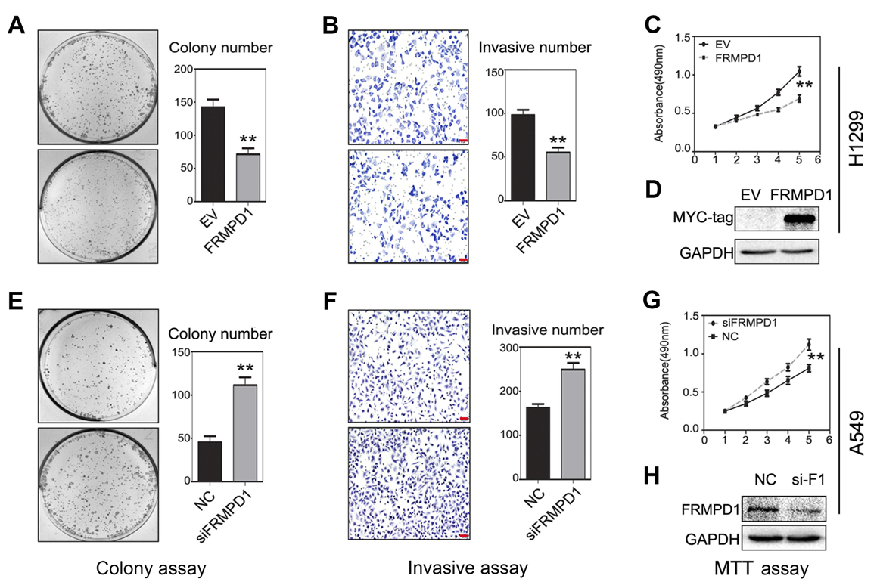
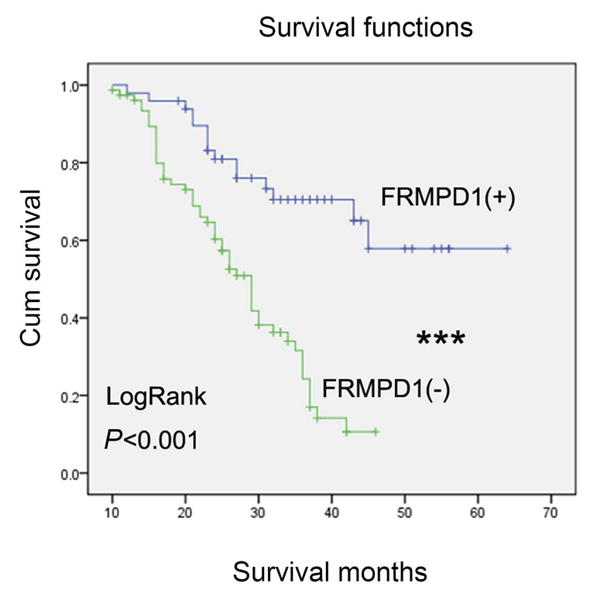
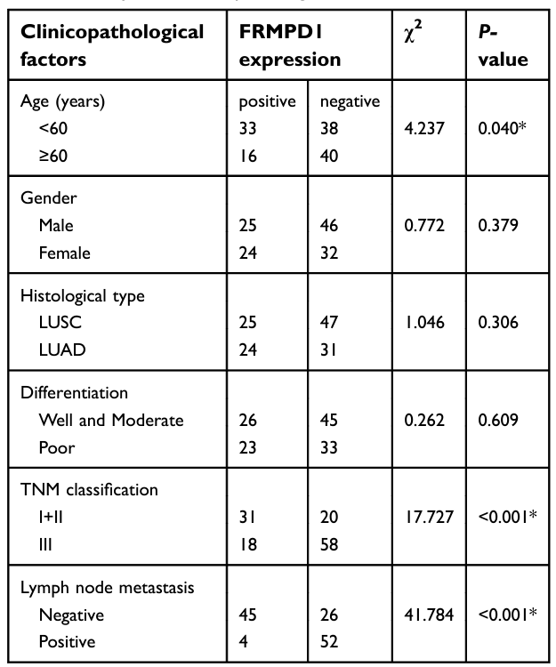
Mutated FRMPD1
(Rong et al. 2019)
Notes:
Even though I didn’t find the specific mutation in lung cancer, but I did find an article that wanted to study the FRMD1 expression in malignant tumors including lung cancer and they were able to find that FRMPD1 expression in lung cancer specimens was lower than that in normal bronchial epithelium and normal submucosal glands. The expression of FRMPD1 in malignant tumors, especially in lung cancer, and its possible biological effects have not yet been reported. There was a study that showed that FRMPD1 expression was negatively correlated with a patient’s age, high TNM stage, and lymph node metastasis. Additionally, Kaplan-Meier survival analysis showed that FRMPD1-positive patients survived significantly longer than FRMPD1-negative patients, suggesting that FRMPD1 could be recognized as a prognostic factor for lung cancer. Moreover, ectopic expression of FRMPD1 significantly inhibited the proliferation and invasion of lung cancer cells, and inhibition of FRMPD1 expression led to opposite effects. These data suggested that FRMPD1 might play a role as a tumor suppressor gene in the development of lung cancer.
https://www.ncbi.nlm.nih.gov/pmc/articles/PMC6497479/#:~:text=FRMPD1%20inhibits%20the%20malignant%20phenotype,activator%20of%20the%20Hippo%20pathway.

Slide 16
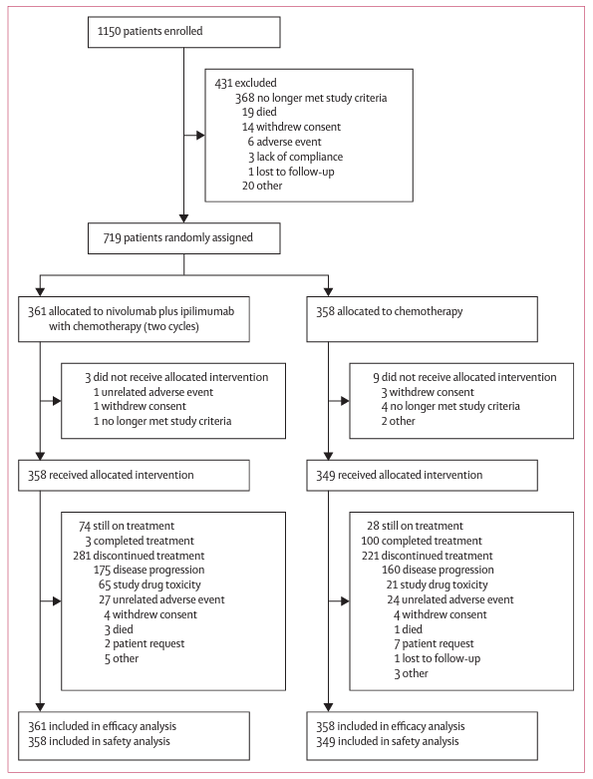
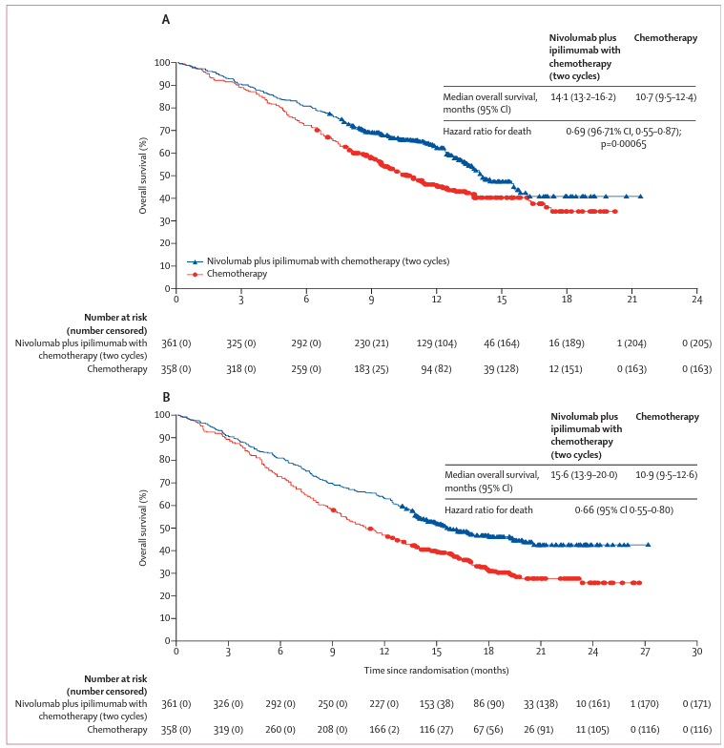
Clinical studies
(Paz-Ares et al. 2021)
Notes:
The first line treatment nivolumab in combination with ipilimumab has shown improved overall survival in patients with advanced NSCLC. In this clinical study, the wanted to investigate whether adding a limited course (2 cycles) of chemotherapy in addition to the combination would enhance the clinical benefits. 719 Patients were randomly assigned to nivolumab and ipilimumab combined with 2 cycles of chemotherapy or 4 cycles of chemotherapy alone. Nivolumab plus ipilimumab with two cycles of chemotherapy provided a significant improvement in overall survival versus chemotherapy alone and had a favourable risk–benefit profile. This is why the combination is considered the new first line treatment option for patients with advanced NSCLC
Clinical study on the combination
Why it worked better with chemotherapy- https://www.thelancet.com/journals/lanonc/article/PIIS1470-2045(20)30641-0/fulltext

Slide 17
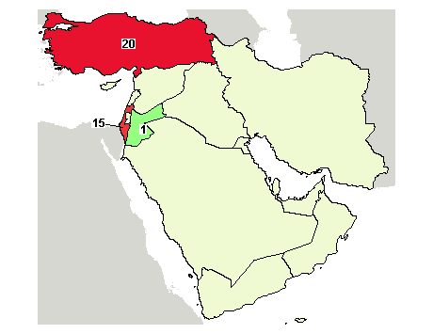
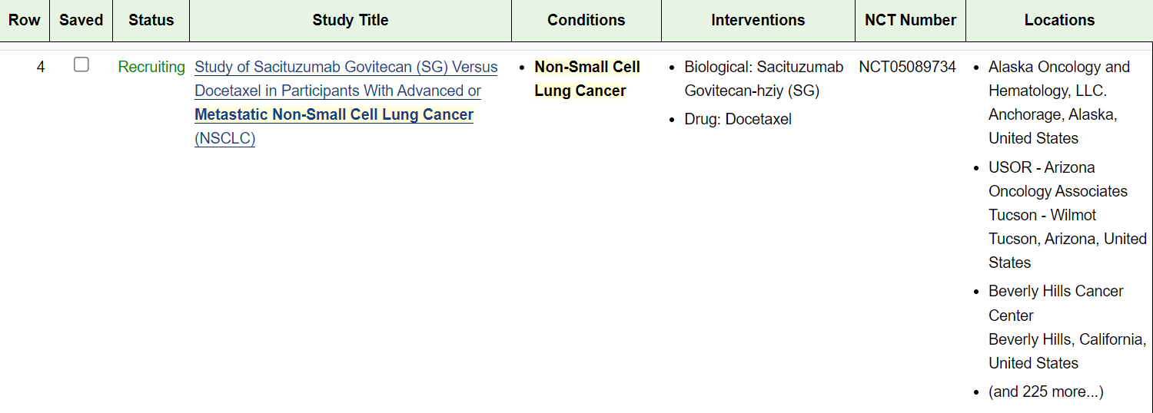
Recommendations
According to NCCN if patients with advanced NSCLC are given nivolumab + ipilimumab + chemotherapy and there is progression, then they unfortunately should look into palliative care
Notes:
However, when I searched for Non-small cell lung cancer stage IV alone, I found 15 studies in israel. Of those, only one seemed like it would work with her case

Slide 18
Thank you!
Any questions?

