Slide 1
Gastrointestinal stromal tumor (GIST) Case presentation
Yana Senderovych

Slide 2
Patient history
A 66-year-old patient
On 21/10/2021 referred to the oncological clinic of Hadassah medical center with a diagnosis of GIST
CT: lobular heterogonous finding involving the small intestine in the right lower abdomen with peritoneal metastasis
Biopsy on 4/10/2021
Prominent eosinophilic/clear cytoplasm; mitotic figures are not seen
The tumor cells are highlighted by IHC stains for S-100, c-kit, and DOG-1

Slide 3
Diagnosis
Gastro-intestinal stromal tumor (GIST)
Sarcoma
Mostly derived from precursors of the interstitial cells of Cajal (ICC)
Frequent symptoms: Bleeding, pain, and/or obstruction
Notes:
.

Slide 4
Common mutations
GISTs are characterized by the presence of activating mutations in the KIT or PDGFRA genes, which encode receptor tyrosine kinases involved in cell growth and survival

Slide 5
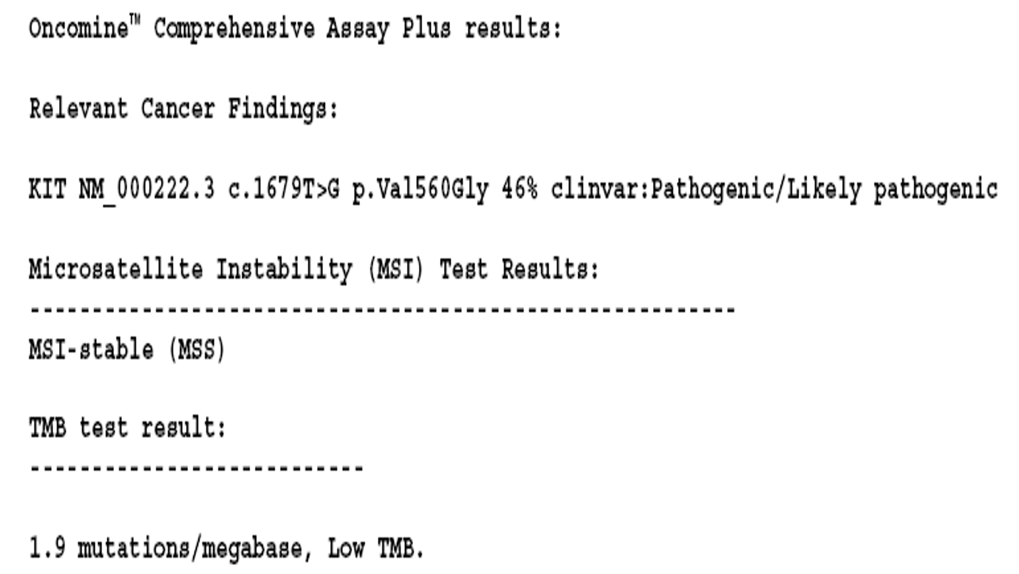
Molecular findings

Slide 6
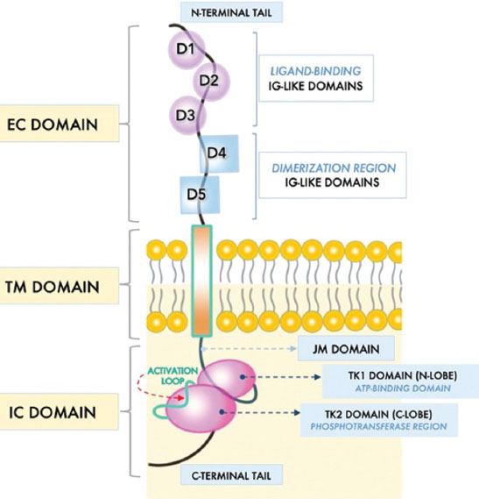
KIT gene
Protooncogene
Receptor Tyrosine Kinase

Slide 7
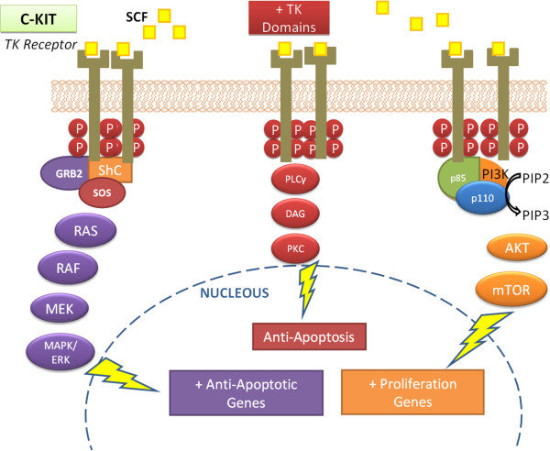
KIT functions
Hematopoiesis
Melanogenesis
Gastrointestinal motility

Slide 8
KIT mutation
KIT gene mutations associated with GISTs create a protein that no longer requires binding of the stem cell factor protein to be activated
KIT protein and the signaling pathways are constantly turned on
An increase in the proliferation and survival of ICCs
GIST formation

Slide 9
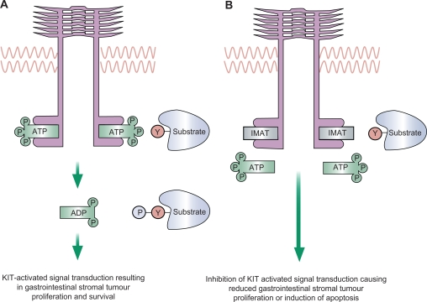
The first line of treatment – Tyrosine Kinase inhibitor Imatinib
Binds to the ATP-binding pocket of KIT
Inhibits downstream signaling

Slide 10
1 Nov. 21
On 1/11 /21 started treatment with imatinib 400 mg once daily
17 Nov. 2021
CT WHOLE BODY slight decreased in the dominant tumor size ,stable disease in peritoneum
6 Jan. 2022
stable disease
24 Apr. 2022
Pet 24/04/2022 no change in the dominant tumor size in the right lower abdomen ' the small tumors increased in size and one of them was increased in uptake

Slide 11
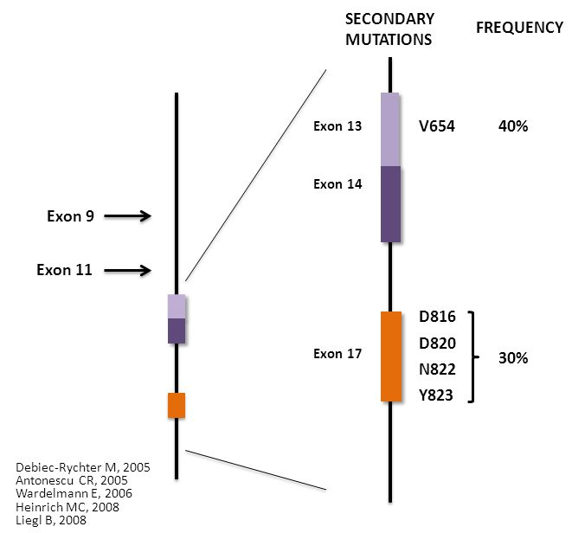
Resistance?
Secondary mutations involving the ATP binding pocket were found to directly inhibit imatinib binding.

Slide 12
Further actions?

Slide 13
Several options for patients with limited progression
If previously treated with standard-dose imatinib
Switch to sunitinib
Dose escalation of imatinib (may be most effective for patients with KIT exon 9 mutation)
Treating with the same dose of TKI and consider the following options for lesions progressing on imatinib or avapritinib:
Resection
Palliative radiation therapy (RT)
- No clinical trials available

Slide 14
More molecular findings
RECQL
DNA helicase
Homologous recombination repair
Response to replication stress.
FANCA
DNA damage response
Fanconi anemia

Slide 15
Thank you!

