Slide 1
Patient 1 Tumor Board
Chaviva Tovey

Slide 2
Case
Patient's medical history
A 67 year old man, On 12/18 refered to the surgical department of the Hadassah Medical Center due to an obstructing colon mass. On 12/18 treated with recto-sigmoid and bladder resection and right hemicolectomy on pathology two stage II tumors, adenocarcinoma. On 3/19 treated with Capcetabine. On 8/19 PET-CT demonstrated peritoneal spread. On 9/19 treated with 5-flurouracil in combination with leucovorin and oxaliplatin. On 1/20 treated with metastectomy on pathology metastatic mucinous adenocarcinoma. On 5/21 began treatment with irinotecan in combination with bevacizumab.
Notes:
Adenocarcinoma- From epithelial cells, glandular tissue,
Colon cancer
Metachronus-spread after treatment of original tumor

Slide 3
NCCN

Slide 4
NCCN
Notes:
Bevacizumab- Angiogenesis inhibitor monoclonal antibody
Irinotecan-

Slide 5
Drug availability

Slide 6
Molecular tests
Exome of blood –
DPYD c.1905+1G>A Heterozygous
Oncomine
KRAS c.35G>A p.Gly12Asp 12% ClinVar: PATHOGENIC
BRCA1/2 – wild type
MMR – proficient
HER2 – negative
NTRK – Negative
ALK/ROS – Negative.
OCA
KRAS p.(G12D) c.35G>A 11.4% (Clinvar: PATHOGENIC)
BRAF Not detected
NRAS Not detected
NTRK1 Not detected
NTRK2 Not detected
NTRK3 Not detected
Notes:
DPYD-enzyme that breaks down pyrimidines,
KRAS-promotes cell division and growth,
ATM-Helps control cell damage repair, DNA damage repair,Control the rate of cell growth and division,
PIK3CA-Signaling kinase,
PRMD9- positioning recombination hotspots during meiosis.

Slide 7
Molecular tests
ATM p.(R3008C) c.9022C>T 16% (Clinvar: PATHOGENIC/Likely PATHOGENIC)
PIK3CA p.(N345K) c.1035T>A 13.3% (Clinvar: PATHOGENIC)
DPYD p.(?) c.1905+1G>A 50.6% (Clinvar: drug response. Varsome: PATHOGENIC)
PRDM9 p.(R77*) c.229C>T 9.5% (No data is available. However, this mutation
predicted to be "Uncertain Significance" according to the website "Varsome")
Microsatellite Instability (MSI) Test Results:
----------------------------------------------
MSI-stable (MSS)
Low Tumor Mutational Burden (low TMB) 1.89 Mutations / Megabase
Notes:
ATM-Helps control cell damage repair, DNA damage repair,Control the rate of cell growth and division,
PIK3CA-Signaling kinase,
PRMD9- positioning recombination hotspots during meiosis.

Slide 8
kRAS- Gene function
Located on chromosome 12.
Part of the MapK pathway, sends signals downstream to cell nucleus to divide and proliferate.
kRAS is a GTPase, binds GTP and converts it to GDP as an “on off switch”.

Slide 9
Gene mutation- kRAS
KRAS c.35G>A p.Gly12Asp 12% ClinVar: PATHOGENIC
NM_004985.5
Amino acid substitution: Glycine→Aspartate in GTP binding region.
kRAS is locked in its active state.
Tumor driver

Slide 10
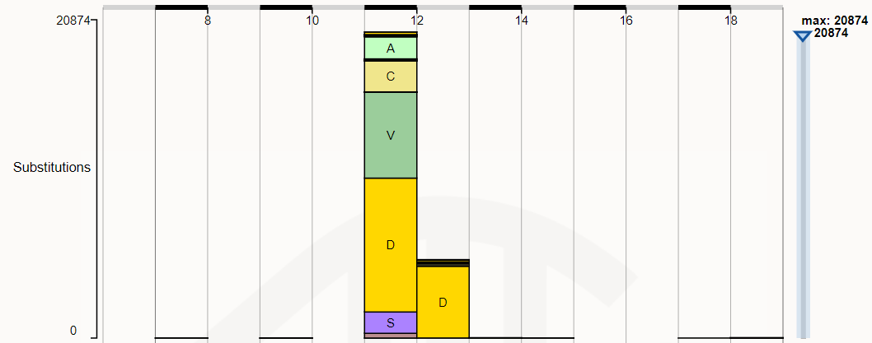
Cosmic- Mutation is known
kRAS mutations are present in 45-50% of colon adenocarcinomas.
Asociated with resitatnce to Cetuximab, Panitumumab, and Vemurafenib.

Slide 11
NCCN

Slide 12
Clinical trials

Slide 13
Recomendations
Continue current course of treatment
Monitor regularly with scans
Keep checking back for new clinical trials that may be relevant

Slide 14
Thank you

