Slide 1
Case report Adi Sheena 22.6.2023
Implementing molecular findings to oncological patients’ care / 94300.

Slide 2
Patient's medical history
A 56 year old man, on 7/20 referred to the immediate care department in the Hadassah Medical Center due to a brain lesion and uncontrolled movement in his right limbs.
On 7-20 brain biopsy was performed, on pathology glial/glioneuronal neoplasm, low grade.
On 11-20 brain biopsy was performed on pathology may be compatible with pleomorphic xanthoastrocytoma.
On 4-22 brain biopsy was performed on pathology Main differential diagnosis includes a CD34-positive, IDH-wildtype low-grade neuroepithelial neoplasm.
On 2-23 brain biopsy was performed on pathology Glioblastoma, IDH-wildtype, CNS WHO grade 4. From 3-23 to 4-23 treated with radiotherapy in combination with temozolomide.

Slide 3
Patient's medical history
OCA
TFG(6) - NTRK2(17) Fusion 1.20% 12731.68654 Read Counts Per Million.
MSI-stable (MSS)
0.95 mutations/megabase, Low TMB

Slide 4
Glioblastoma (GBM)– Background
Glioblastoma is a highly malignant brain tumor that arises from astrocytes, the supportive cells in the nervous system.
Glioblastomas are the third most common primary brain tumor type, accounting for about 14.9% of primary brain tumors.
It's most common in older adults but can occur in children.
The median survival of patients receiving radiotherapy with concomitant and adjuvant temozolomide chemotherapy is improved to 15 months. Still, less than 5% of patients survive over five years due to invariable GBM relapse.
The response of a patient to the treatment depends on a variety of factors; tumors size, location, the amount remaining after surgery.

Slide 5
First line therapy - Glioblastoma, IDH-wildtype, CNS WHO grade 4
The standard treatment according to NCCN is radiotherapy in combination with temozolomide .
Radiotherapy helps target any tumor cells in the brain, while temozolomide is a chemotherapy drug that penetrate the BBB and helps kill cancer cells.

Slide 6
IDH-wildtype VS IDH-mutant
The IDH genes are responsible for producing enzymes that are critical to cells’ ability to produce energy.
Patients with mutant IDH1/2 GBM have a better outcome compared to those with wild-type IDH tumor, due to new effective targeted molecular therapies.
https://doi.org/10.1038/s41388-021-02056-1
Notes:
ecent insights in metabolomic studies have suggested a key role of wild-type IDH enzymes upon treatment to favor GBM proliferation and recurrence [11]. The discovery that patients with mutant IDH1/2 GBM have a better outcome compared to those with wild-type enzymes has spurred robust research to study the consequences of IDH mutations on cellular metabolism and to design new effective targeted molecular therapies.
Hotspot mutation in IDH1 gene has been identified in GBM occuring at the active site within the catalytic pocket, and resulting in a neomorphic activity leading to the generation of (D)2-Hydroxyglutarate (D2HG) while oxidizing NADPH. D2HG, through structural similarity to αKG, acts as a competitive inhibitor leading to inhibition of αKG-dependent dioxygenases, and resulting to epigenetic alteration, HIF1α stabilization, and alterations in cellular differentiation and response to oxidative stress. Tumors with IDH1/2 mutations have distinctive genetic and clinical characteristics. In particular, patients with mutant IDH1/2 GBM have a better outcome compared to those with wild-type IDH tumor.

Slide 7
Patient's medical history
OCA
TFG(6) - NTRK2(17) Fusion 1.20% 12731.68654 Read Counts Per Million.
In this case, the fusion was detected at a low percentage (1.20%), indicating that only a small proportion of the tumor cells harbor this fusion event.
MSI-stable (MSS)
0.95 mutations/megabase, Low TMB

Slide 8
NTRK fusion - TFG(6) - NTRK2(17)
Fusions involving neurotrophic tyrosine receptor kinase (NTRK) genes are detected in ≤2% of gliomas and can promote glioma genesis.
Unsupervised principal component analysis of methylation profiles demonstrated no prominent grouping by histologic grade, NTRK gene involved, or age group.
The tropomyosin receptor kinase (TRK) family of tyrosine receptor kinases is comprised of TRKA, TRKB, and TRKC, which are encoded by neurotrophic tyrosine receptor kinase (NTRK) genes NTRK1, NTRK2, and NTRK3, respectively.

Slide 9
NTRK fusion - TFG(6) - NTRK2(17)
TRK receptors are highly expressed in neural tissue, where they have a physiologic role in neuronal survival, development, proliferation, and synaptic plasticity, as well as memory and cognition
Fusions involving the NTRK genes can be oncogenic drivers, leading to constitutive activation of TRK signaling pathways, and upregulated proliferation and resistance to apoptosis.
TFG - There are several documented fusion oncoproteins encoded partially by this gene. This gene also participates in several oncogenic rearrangements and may play a role in the NF-kappaB pathway.

Slide 10
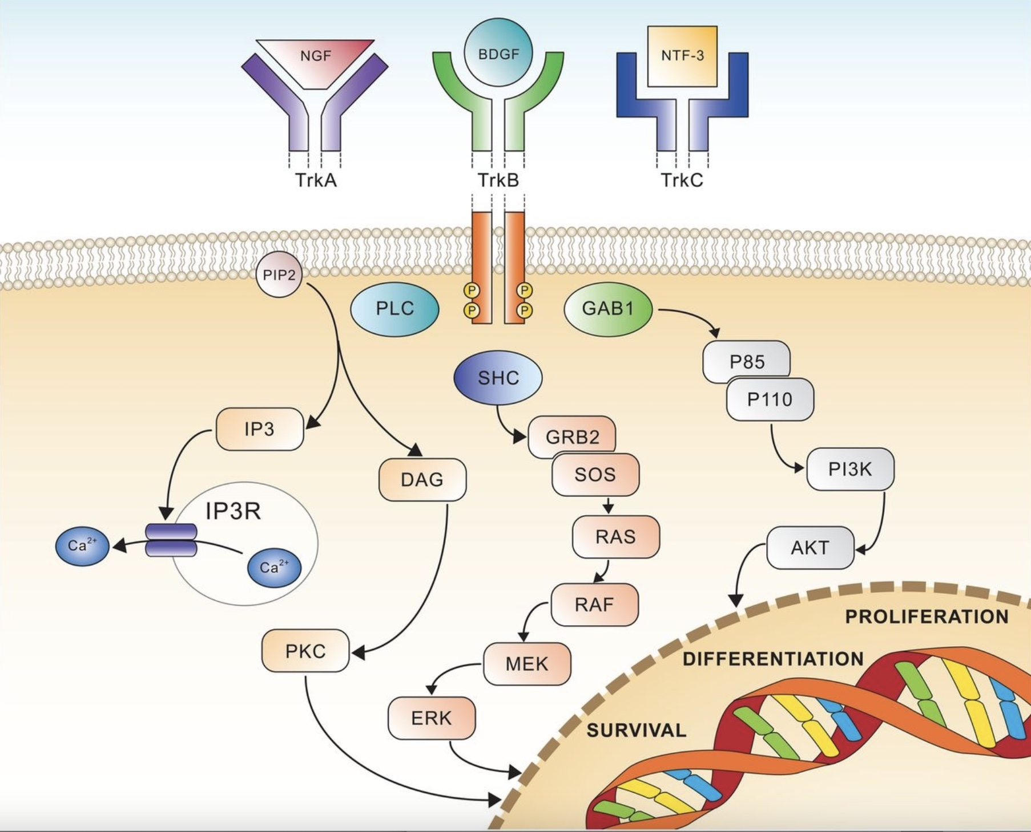
https://doi.org/10.1136/esmoopen-2015-000023
Notes:
chematic view of Trk receptors signalling, showing the three major pathways involved in cell differentiation and survival. AKT, v-akt murine thymoma viral oncogenehomologue; BDGF, brain-derived growth factor; DAG, diacyl-glycerol; ERK, extracellular signal-regulated kinase; GAB1, GRB2-associated-binding protein 1; GRB2, growth factor receptor-bound protein 2; IP3, inositol trisphosphate; MEK, mitogen-activated protein kinase; NGF, nerve growth factor; NTF-3, neurotrophin 3; PI3K, phosphatidylinositol-4,5-bisphosphate 3-kinase; PIP2, phosphatidylinositol 4,5-bisphosphate; PKC, protein kinase C; PLC, phospholipase C; RAF, rapidly accelerated fibrosarcoma kinase; RAS, rat sarcomakinase; SHC, Src homology 2 domain containing.

Slide 11
Patient's Treatment options:
Surgery- aims to obtain a diagnosis, alleviate symptoms related to increased intracranial pressure or compression by tumor, increase survival, and decrease the need for corticosteroids. Surgical intervention is typically considered part of the treatment plan as the patient has been diagnosed with glioblastoma. However, the feasibility and extent of surgical intervention would depend on the location and size of the cancer and the patient's overall health.
Targeted therapy - Small molecule TRK inhibitors Larotrectinib and Entrectinib have shown promising results in patients with NTRK fusion-positive tumors. However, the decision to use targeted therapy would depend on factors such as the availability of specific targeted agents, the extent of NTRK fusion in the tumor, and the patient's overall condition.

Slide 12
Larotrectinib
While some efficacy has been reported with larotrectinib in case reports and early clinical studies, there have been no published reports of the successful use of entrectinib in adult gliomas, including glioblastoma (GBM).
Larotrectinib is a first-in-class, highly selective tropomyosin receptor kinase (TRK) inhibitor approved to treat adult and pediatric patients with TRK fusion-positive cancer.
larotrectinib binds to Trk, thereby preventing neurotrophin-Trk interaction and Trk activation, which results in both the induction of cellular apoptosis and cell growth inhibition in tumors that overexpress Trk.

Slide 13
Clinical trials
Since glioblastoma is an aggressive and challenging cancer, participation in clinical trials may be an option worth considering.
Mycophenolate Mofetil in combination with standard of care for the treatment of Glioblastoma - Mycophenolate mofetil is an immunosuppressant drug typically used to prevent organ rejection in transplant recipients. However, it may also help chemotherapy with temozolomide work better by making tumor cells more sensitive to the drug - USA Illinois

Slide 14
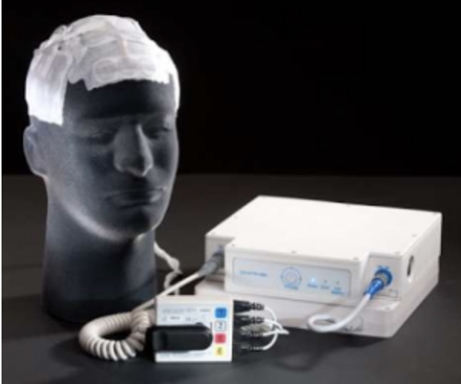
Alternating electric field therapy
Alternating electric field therapy, sometimes called tumor treating fields (TTFields), is a type of electromagnetic field therapy using low-intensity, intermediate frequency electrical fields to stop mitosis/ cell division and treat cancer.

Slide 15
Conclusions:
This patient went through multiple biopsies; at the latest, he was diagnosed with Glioblastoma, IDH-wildtype, CNS WHO grade 4, and started receiving standard radiotherapy care combined with temozolomide.
Patients with malignant gliomas eventually develop tumor recurrence or progression, meaning that cancer will most likely be incurable and reassured after surgery if possible.
Multiple treatment options should be considered after discussing with a professional who evaluates the patient's overall condition and determines which choice is possible.

Slide 16
Recommendations:
The primary goal of the treatment is to palliate the passage of the disease.
Unfortunately, there is no established second-line therapy for recurrent gliomas.
Keep the standard care and look for neurosurgical input to consider maximal safe resection if possible. In addition, consider adding alternating electric field therapy in combination with standard care.

Slide 17
Thank you for listening! Questions?

