Slide 1
Implementing Molecular Findings to Oncological Patients' Care
Dr. Aviad Zick
Tehila Ernst

Slide 2
Patient's medical history
A 58-year-old woman. On 1/2015 presented to the emergency room of Hadassah Medical Organization. In the previous week suffered from aphasia. On CT two brain lesions were demonstrated. She was treated with craniotomy and resection of one of the masses on pathology adenocarcinoma compatible with lung, EGFR/ALK wildtype, HER2 NEG, MMR-P. A chest CT revealed a mass and mediastinal lymphadenopathy.
Treated with radiotherapy to brain lesions until 27/3/16.
Treated with radiotherapy to lung and mediastinum until 5/16.
Between 4/15-11/15 – treated with pemetrexed in combination with carboplatin and bevacizumab. Currently treated with bevacizumab with stable disease.
Molecular landscape
Foundation1:
RET KIF5B-RET fusion
HGF amplification
RICTOR amplification
NKX2-1 amplification
SETD2 K2456fs*8

Slide 3
Recognizing cancer type

Slide 4
Cancer stage
Stage IV
non-small cell lung cancer (NSCLC) is the most advanced form of lung cancer. In stage IV, the cancer has metastasized, or spread, to the lining of the lung or other areas of the body.
https://www.lung.org/lung-health-diseases/lung-disease-lookup/lung-cancer/symptoms-diagnosis/lung-cancer-staging

Slide 7
Molecular test results
Molecular landscape
Foundation1
RET KIF5B-RET fusion
HGF amplification
RICTOR amplification
NKX2-1 amplification
SETD2 K2456fs*8
EGFR/ALK wildtype.
HER2 NEG,
MMR-P

Slide 8
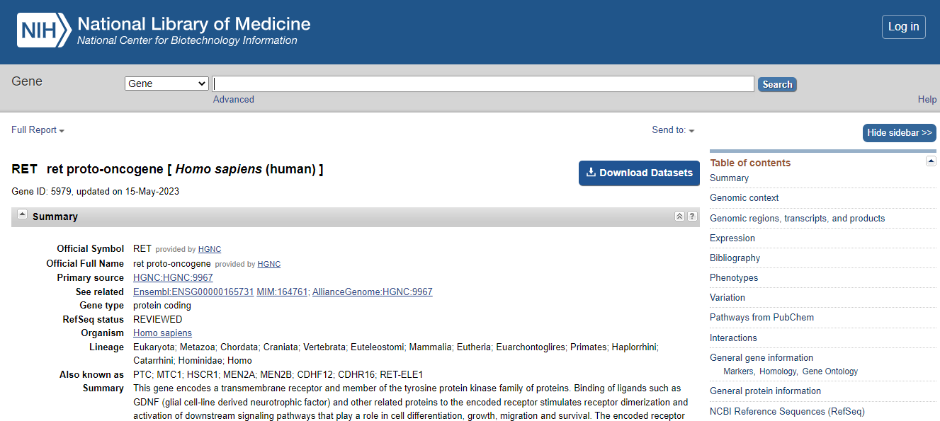
RET (rearranged during transfection)

Slide 9
RET (rearranged during transfection)
Proto-oncogene.
Tyrosine protein kinase, transmembrane receptor.
Binding of ligands stimulates receptor dimerization and activation of downstream signaling pathways that play a role in cell differentiation, growth, migration, and survival.
Important in the development of the nervous system, and organs and tissues derived from the neural crest.
It can undergo oncogenic activation through both cytogenetic rearrangement and activating point mutations.
Bahlakeh, Gozal, et al. "Current knowledge and challenges associated with targeted delivery of neurotrophic factors into the central nervous system: focus on available approaches." Cell & Bioscience 11.1 (2021): 1-24.‏

Slide 10
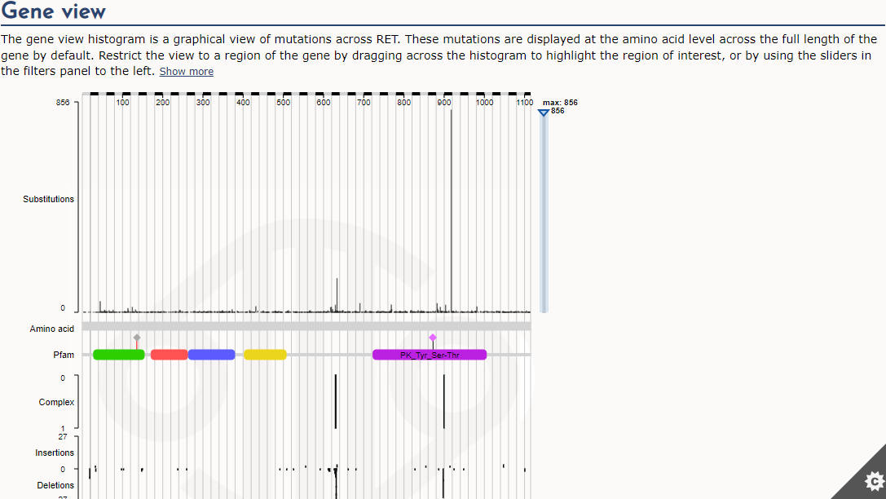

Slide 12
KIF5B-RET fusion
Rearrangements between the RET gene and KIF5B lead to overexpression of the RET protein (2-30-fold higher RET expression).
The KIF5B-RET proteins are likely to form a homodimer through the coiled-coil domain of KIF5B, causing an aberrant activation of the kinase function of RET
The KIF5B-RET fusion is a driver mutation.
Kohno, Takashi, et al. "KIF5B-RET fusions in lung adenocarcinoma." Nature medicine 18.3 (2012): 375-377.‏

Slide 13
Prognosis
The incidence of RET fusion-positive NSCLC is similar in men and women.
The proportion of patients with NSCLC who have RET rearrangements is approximately 1%-2%.
RET fusion-positive NSCLC has typical clinical features, such as younger age at onset and a low smoking rate.
NSCLC patients with RET gene rearrangement have a poor prognosis and are more likely to develop distant metastasis.
Shen, Zixiong, et al. "Targeted therapy of RET fusion-positive non-small cell lung cancer." Frontiers in Oncology 12 (2022).‏

Slide 14
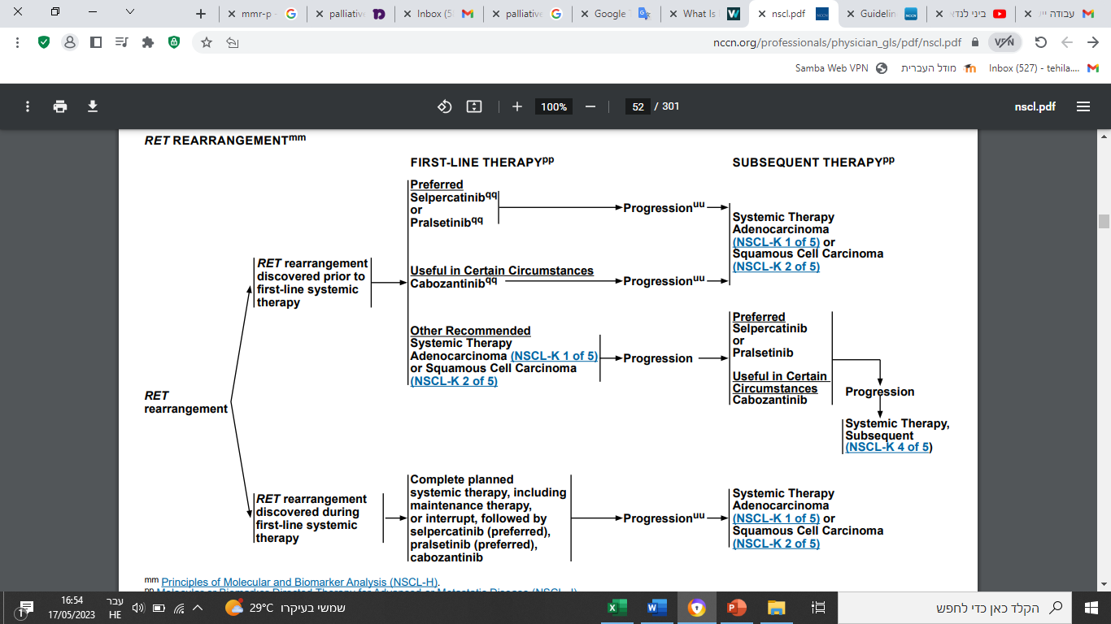

Slide 15
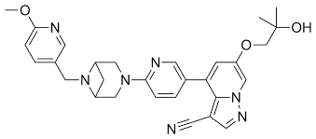
Selpercatinib
Selpercatinib is a kinase inhibitor, meaning it blocks a type of enzyme (kinase) and helps prevent the cancer cells from growing.
It is the first therapy approved specifically for people with cancer and RET gene alterations.

Slide 16
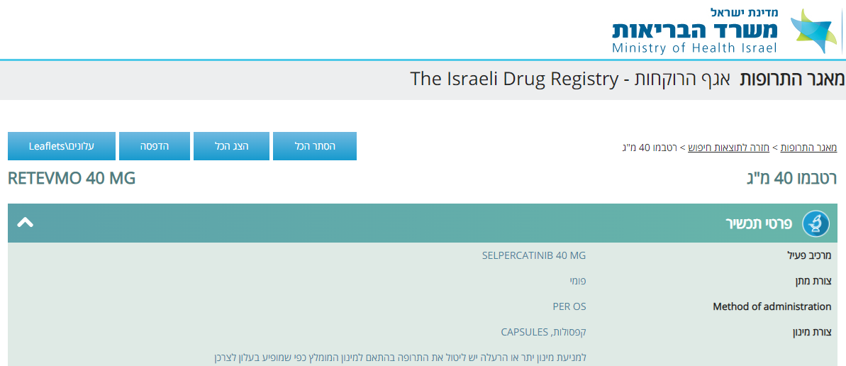
Selpercatinib

Slide 17
Pralsetinib
Pralsetinib is a tyrosine kinase inhibitor. It is taken by mouth.
It is indicated for the treatment of adults with metastatic RET fusion-positive non-small cell lung cancer (NSCLC) as detected by an FDA-approved test.

Slide 18
Pralsetinib

Slide 19
Pralsetinib

Slide 20
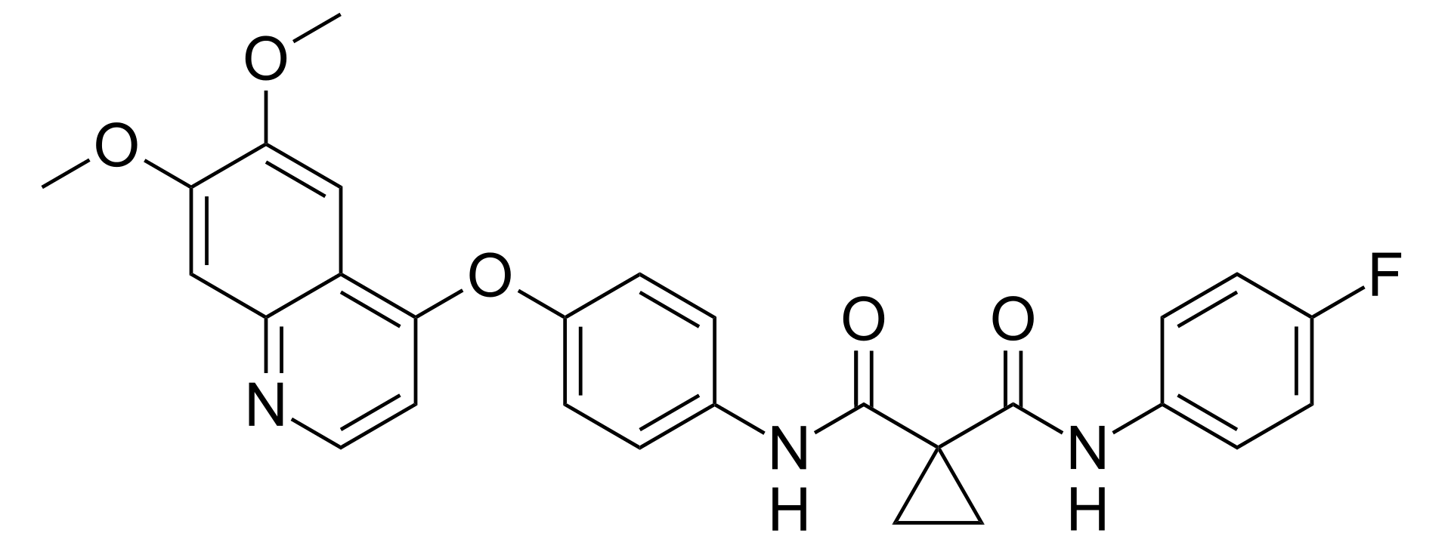
Cabozantinib
Cabozantinib is an anti-cancer medication It is a small molecule inhibitor of the tyrosine kinases c-Met and VEGFR2, and also inhibits AXL and RET.
Cabozantinib is being researched for efficacy as a treatment for some cancer types, including non-small cell lung cancer (NSCLC)

Slide 21
Cabozantinib

Slide 22
Patient's medical history
A 58-year-old woman. On 1/2015 presented to the emergency room of Hadassah Medical Organization. In the previous week suffered from aphasia. On CT two brain lesions were demonstrated. She was treated with craniotomy and resection of one of the masses on pathology adenocarcinoma compatible with lung, EGFR/ALK wildtype, HER2 NEG, MMR-P. A chest CT revealed a mass and mediastinal lymphadenopathy.
Treated with radiotherapy to brain lesions until 27/3/16.
Treated with radiotherapy to lung and mediastinum until 5/16.
Between 4/15-11/15 – treated with pemetrexed in combination with carboplatin and bevacizumab. Currently treated with bevacizumab with stable disease.
Molecular landscape
Foundation1
RET KIF5B-RET fusion
HGF amplification
RICTOR amplification
NKX2-1 amplification
SETD2 K2456fs*8

Slide 24
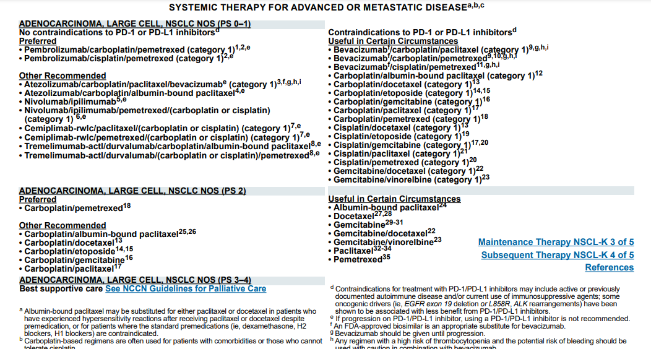

Slide 25
Patient's medical history
A 58-year-old woman. On 1/2015 presented to the emergency room of Hadassah Medical Organization. In the previous week suffered from aphasia. On CT two brain lesions were demonstrated. She was treated with craniotomy and resection of one of the masses on pathology adenocarcinoma compatible with lung, EGFR/ALK wildtype, HER2 NEG, MMR-P. A chest CT revealed a mass and mediastinal lymphadenopathy.
Treated with radiotherapy to brain lesions until 27/3/16.
Treated with radiotherapy to lung and mediastinum until 5/16.
Between 4/15-11/15 – treated with pemetrexed in combination with carboplatin and bevacizumab. Currently treated with bevacizumab with stable disease.
Molecular landscape
Foundation1
RET KIF5B-RET fusion
HGF amplification
RICTOR amplification
NKX2-1 amplification
SETD2 K2456fs*8

Slide 26
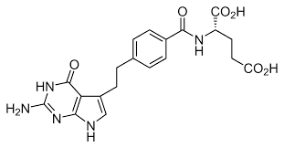
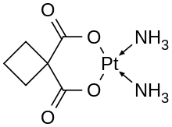
Chemotherapy treatment
pemetrexed is a type of chemotherapy. It works by inhibiting enzymes used in nucleotide synthesis and thus prevents the formation of DNA and RNA, which are required for the growth and survival of both normal cells and cancer cells.
Carboplatin (or Paraplatin) is a chemotherapy medication. works by interfering with the duplication of DNA.

Slide 27
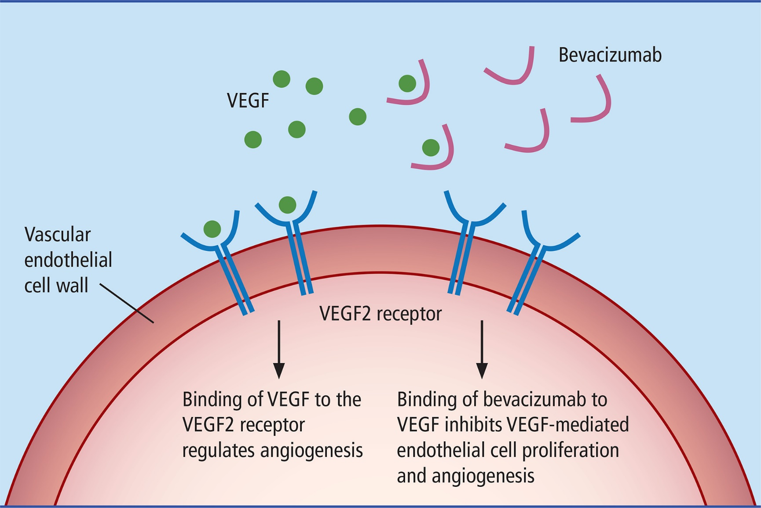
Anti–VEGF treatment
Bevacizumab is a monoclonal antibody that functions as an angiogenesis inhibit.
It is an anti–VEGF therapy that works by slowing new blood vessel growth by inhibiting vascular endothelial growth factor A (VEGF-A).

Slide 29
International, Phase 3 study
potent and selective RET inhibitor, pralsetinib,
for participants with RET fusion-positive metastatic NSCLC who have not previously received systemic anticancer therapy for metastatic disease.
Participants who have centrally confirmed progressive disease on the control arm have the option to crossover to pralsetinib.

Slide 30
Treatment recommendation
In our time, medicine has been developed and there are specific drugs that can affect NSCLC cancer cells with RET rearrangement.
Therefore, I think the best drug for this patient is Pralsetinib, which:
1- specific for inhibiting tyrosine kinase.
2- approved and subsidized by the Ministry of Health.

Slide 31
Thank you!
Questions?

