Slide 1
Case report Adi Sheena 22.5.2023
Implementing molecular findings to oncological patients’ care / 94300.

Slide 2
Patient's medical history
A 39 year old women, referred 9/9/2019 to the emergency room of the Hadassah medical center due to dizziness and falls. On imaging lung, liver and brain lesions.
A liver biopsy was performed on pathology Metastatic carcinoma of lung, non-small cell type, ROS translocated, PDL1 – strongly positive.
Treated on 25/9/2018 with pemetrexed in combination with carboplatin and bevacizumab.
Treated with Crizotinib with partial response.
Due to progressive disease treated from 6/19 with brigatinib.
From 7/7/2019 treated with pembrolizumab in combination pemetrexed, carboplatin and bevacizumab with progressive disease.
On 22/12/2019 treated with LORLATENIB.

Slide 3
Patient's medical history
Oncomine -wildtype
MMR – proficient
FOUNDATIONONE –
ROS1 CD74
CDKN2A p16INK4a E88* and p14ARF G102V
TP53 E258Q

Slide 4
Non-small cell lung cancer NSCLC– Background
Lung cancer is the leading cause of cancer death in the United States; only 22.9% of all patients with lung cancer are alive five years or more after diagnosis.
Common symptoms of lung cancer include cough, hemoptysis, dyspnea, weight loss, and chest pain; patients with symptoms are more likely to have chronic obstructive pulmonary disease (COPD).
Patients with NSCLC eligible for targeted therapies or immunotherapies are now surviving longer; 5-year survival rates range from 15% to 50%, depending on the biomarker.
The primary risk factor for lung cancer is smoking tobacco, which accounts for most lung cancer-related deaths. Other possible risk factors for lung cancer include disease history (e.g., COPD), cancer history, family history of lung cancer, and exposure to other carcinogens.

Slide 5
First line theraphy - Metastatic NSCLC, ROS translocated, PDL1 – strongly positive :
Treated on 25/9/2018 with pemetrexed in combination with carboplatin and bevacizumab.
Pemetrexed - is a chemotherapy medication for the treatment of non-small cell lung cancer and malignant mesothelioma, It works by inhibiting three enzymes used in purine and pyrimidine synthesis thus prevents the formation of DNA and RNA, which are required for the growth and survival of both normal cells and cancer cells.
Carboplatin - is an intravenously administered platinum coordination complex and alkylating agent which is used as a chemotherapeutic agent for the treatment of various cancers, mainly ovarian, head and neck and lung cancers.
Bevacizumab - is a humanized monoclonal antibody against vascular endothelial growth factor A (VEGF-A). It is used to treat several different cancers.

Slide 6
Patient's medical history
Oncomine -wildtype
MMR – proficient
FOUNDATIONONE –
ROS1 CD74
CDKN2A p16INK4a E88* and p14ARF G102V
TP53 E258Q

Slide 7
ROS translocated -ROS1 CD74 fusion
ROS1 is a receptor tyrosine kinase belonging to the insulin receptor family .
It is estimated that ROS1 gene rearrangements occur in about 1% to 2% of patients with NSCLC .
The first report of ROS1 rearrangements in lung cancer dates to 2007 leading to constitutive kinase activation and conferring sensitivity in vitro to TKIs.
The ROS1-CD74 fusion is the most common, accounting for 44% of cases.
CD74 is a protein encoded by this gene associated with MHCII and is a critical chaperone that regulates antigen presentation for immune response.
Data showing the efficacy of crizotinib, ceritinib, and entrectinib for patients with ROS1 rearrangements as first-line monotherapy options.

Slide 8
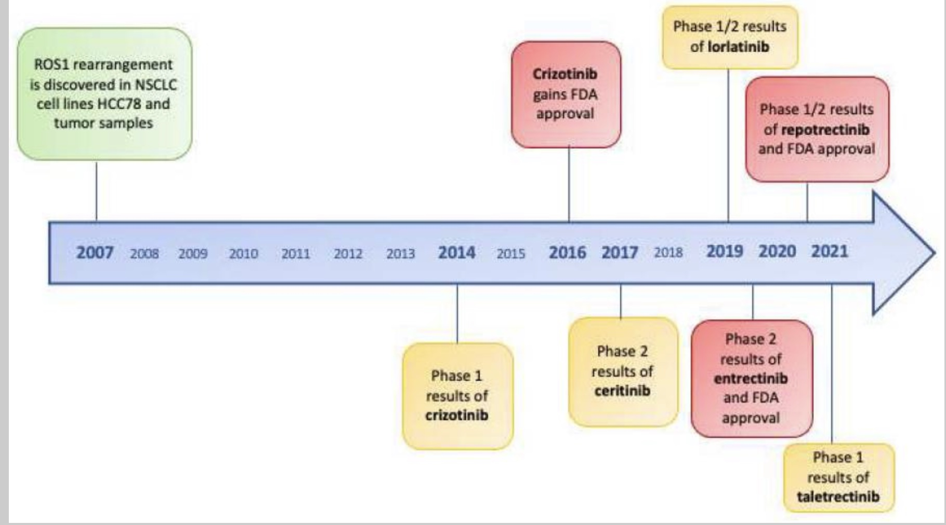
Timeline of ROS1 tyrosine kinase inhibitors and FDA approvals since discovery
doi: 10.3390/ijms222312867

Slide 9
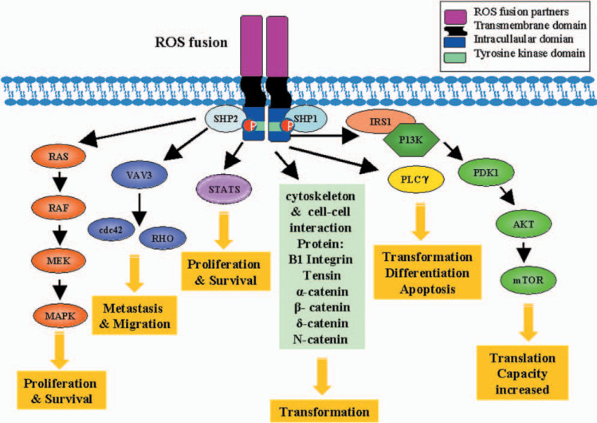
ROS translocated -ROS1 CD74 fusion
In lung cancer, the ROS1 mutation is caused by genetic changes called fusion. The ROS1 gene, which encodes the tyrosine kinase protein, plays a role in the division and growth activities of the cell. Due to the mutation in the ROS1 gene, cancer occurs because of uncontrolled cell growth.
https://doi.org/10.1097/JTO.0b013e31826baf83
Notes:
ROS1 engages multiple signalling pathways to exert its transformation activity. PLCγ, MAP kinase, IRS1 (signalling molecule to PI3K), VAV3, STATS, cytoskeleton and cell-to-cell interaction (β-integrin, tensin, α-, β-, Δ-catenin, N-catenin) proteins can interact with ROS1, and phospohorylation of these proteins by ROS1 can lead to activation of the respective oncogenic pathways. ROS autophosphorylation sites are docking sites for the tyrosine phosphatases SHP-1 and SHP, Src-homology 2 domain-containing phosphatase; ROS1, c-ros oncogene 1, receptor tyrosine kinase c-ros oncogene 1, receptor tyrosine kinase; PLCγ, phospholipase C, gamma; MAP, mitogen-activated protein kinase; IRS1, insulin receptor substrate 1; VAV3, vav 3 guanine nucleotide exchange factor 1; STATS, signal transducers and activators of transcription-3; PDK1, pyruvate dehydrogenase kinase, isozyme 1; AKT (v-akt murine thymoma viral oncogene homolog 1); mTOR, mechanistic target of rapamycin(serine/threonine kinase); P13K, phosphoinositide-3 kinase; and RHO, rhodopsin.

Slide 10
Patient's medical history
Treated with Crizotinib with partial response.
The majority (up to 60%) of crizotinib-resistant has secondary mutations occur in the kinase domain, but the activation of bypass signaling pathways (such as EGFR) has also been described.
Due to progressive disease treated from 6/19 with Brigatinib - which demonstrated modest activity in crizotinib-resistant ROS1-rearranged NSCLC.

Slide 11
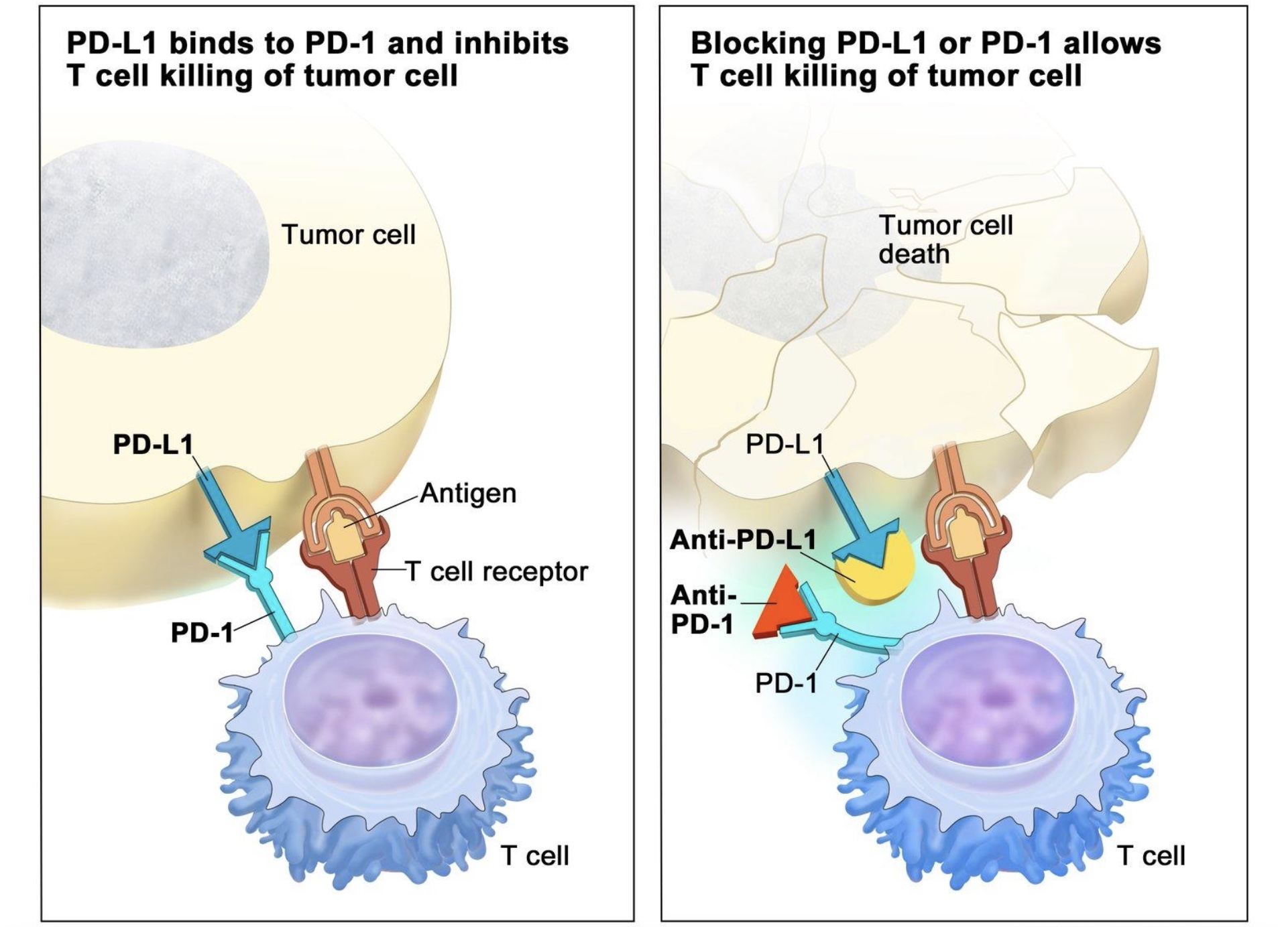
PDL1 –positive
The prevalence of PD-L1 expression in the population of patients with NSCLC ranges from 24% to 60%, even with a cutoff for positivity set at 5%.
It is believed that PD-L1 expression allows cancer cells to avoid the immune response.
https://www.cancer.gov/about-cancer/treatment/types/immunotherapy/checkpoint-inhibitors

Slide 12
Second line therapy
Patients with metastatic NSCLC and PD-L1 expression levels of 1% or more—but who also have a targetable driver oncogene molecular variant—should receive first-line targeted therapy for that oncogene and not first-line ICIs.
Cemiplimab-rwlc, nivolumab, and pembrolizumab inhibit PD-1 receptors. Atezolizumab and durvalumab inhibit PD-L1.
From 7/7/2019 treated with pembrolizumab in combination pemetrexed, carboplatin and bevacizumab with progressive disease.

Slide 13
Patient's medical history
FOUNDATIONONE –
ROS1 CD74
CDKN2A p16INK4a E88* and p14ARF G102V - may cause cells to grow and divide too quickly or in an uncontrolled way or may keep cells from undergoing apoptosis.

Slide 14
Patient's medical history
FOUNDATIONONE –
ROS1 CD74
CDKN2A p16INK4a E88* and p14ARF G102V - may cause cells to grow and divide too quickly or in an uncontrolled way or may keep cells from undergoing apoptosis.
TP53 E258Q

Slide 15
TP53 wt VS mt
Cancers 2021, 13, 479. https://doi.org/10.3390/cancers13030479
Notes:
Wild-type (wt) versus mutant (mt) p53 in tumorigenesis and cancer therapy. p53 tumor suppressor maintains a Figure 1. Wild-type (wt) versus mutant (mt) p53 in tumorigenesis and cancer therapy. p53 tumor
long-term anti-cancer environment in normal cells by tuning cell metabolism and reactive oxygen species (ROS) levels,
suppressor maintains a long-term anti-cancer environment in normal cells by tuning cell metabo-
maintaining the genomic stability and microenvironment. It also copes with stress (e.g., DNA damage) by imposing cell
lism and reactive oxygen species (ROS) levels, maintaining the genomic stability and microenvi-
cycle arrest and, eventually, cellular senescence or regulated cell death (RCD) [20]. Wt p53, via its target genes in long-term ronment. It also copes with stress (e.g., DNA damage) by imposing cell cycle arrest and, eventu-
cancerpreavlelyn,ticoenll,urleagruselantescecnelcleuloarrrmegeutalabtoedliscmellmdaeianthly(RbyCDsu)p[2p0r]e.sWsintgp5g3l,yvcioalyitssist,aregnehtagnecninesgiDnNloAngr-epair,reflecting cellularstrteesrsm,mcoandcuelratpinregvRenOtSiolne,vreelsg,ualnatdesuceplplurelasrsimngetcaeblloulilsamrinmvaisnilvyenbeyssu.pCparnecsesri-nagssgolcyicaotelydspis5,3enmhuatnacn-ts,incontrast,
ing DNA repair, reflecting cellular stress, modulating ROS levels, and suppressing cellular inva-
block/attenuate wt p53 function(s) and enhance tumor initiation, progression, and invasiveness by suppressing DNA repair,
siveness. Cancer-associated p53 mutants, in contrast, block/attenuate wt p53 function(s) and en-
immune response, and response to cancer therapy (attenuating RCD) and enhancing cell proliferation, migration, and
hance tumor initiation, progression, and invasiveness by suppressing DNA repair, immune re-
metastases [21,22]. Mutant p53 in cancer cells can be partly rescued by mt-to-wt p53 reactivation compounds [23] or mt p53 sponse, and response to cancer therapy (attenuating RCD) and enhancing cell proliferation, migra-
can be exploited for therapy via synthetic lethality. Diet and environmental carcinogens represent environmental and mi-
tion, and metastases [21,22]. Mutant p53 in cancer cells can be partly rescued by mt-to-wt p53 reac-
croenvironmental (including interaction of diet with microbiota) etiological factors involved in sporadic carcinogenesis [24]. tivation compounds [23] or mt p53 can be exploited for therapy via synthetic lethality. Diet and

Slide 16
TP53 E258Q mutation – loss of function
Tumor protein 53 (TP53) gene is the most frequently mutated gene in cancer, including NSCLC.
TP53 mutations can induce carcinogenesis, tumor development and resistance to therapy, influencing patient prognosis and responsiveness to therapy.
TP53 E258Q lies within the DNA-binding domain of the Tp53 protein.
In recent years, many associations between different TP53 mutations and responses to Epidermal Growth Factor Receptor (EGFR) targeted therapy and resistance to Tyrosine-Kinase Inhibitors.

Slide 17
Patient's medical history
On 22/12/2019 treated with LORLATINIB.
Lorlatinib, a third-generation inhibitor of anaplastic lymphoma kinase (ALK), has antitumor activity in previously treated patients with ALK-positive non-small-cell lung cancer (NSCLC).
Phase 2 in clinical trials for metastatic NSCLC with ROS1 fusion: Because of its potency as a ROS1 inhibitor and its ability to suppress the resistant ROS1 mutations, lorlatinib could be a treatment of choice in ROS1-positive NSCLC.

Slide 18
Conclusions:
The late imaging of this patient revealed a lesion in the brain and the liver, indicating the progression of the disease, meaning that the cancer is most likely to be incurable, and the main goal of the treatment is to palliate the progression of the disease.
Looking for clinical trials suitable for this patient's condition showed that the clinical trial available is for treatment with Lorlatinib, currently in phase 2, which she is already receiving.
Due to the advanced state and the lesion in the brain, external beam-RT is also needed. New evidence shows that in the modern era, RT serves not only as a palliative tool in metastatic NSCLC but also plays active roles in patients with oligo-focal disease, CNS metastasis, and receiving ICIs.

Slide 19
Recommendations:
Systemic therapy is recommended for disseminated disease, and the type depends on histologic type, somatic genomic alteration that are present and can be treated with targeted therapy.
Palliation of symptoms throughout the disease course can be achieved with external beam-RT for distant metastases with localizes symptoms.
Continue with systemic therapy and lorlatinib, considering RT as palliative and active role for brain metastasis, and provide any other palliative treatment for other symptoms if they occure.

Slide 20
Thank you for listening! Questions?

Slide 21
References:
NCCN Clinical Practice Guidelines in Oncology (NCCN Guidelines) Non-Small Cell Lung Cancer, Version 3.2023 — April 13, 2023. https://www.nccn.org/professionals/physician_gls/pdf/nscl.pdf
ROS1 ROS proto-oncogene 1, receptor tyrosine kinase [ Homo sapiens (human) https://www.ncbi.nlm.nih.gov/gene/6098
CD74 CD74 molecule [ Homo sapiens (human)] https://www.ncbi.nlm.nih.gov/gene/972
Guaitoli G, Bertolini F, Bettelli S, Manfredini S, Maur M, Trudu L, Aramini B, Masciale V, Grisendi G, Dominici M, Barbieri F. Deepening the Knowledge of ROS1 Rearrangements in Non-Small Cell Lung Cancer: Diagnosis, Treatment, Resistance and Concomitant Alterations. Int J Mol Sci. 2021 Nov 28;22(23):12867. doi: 10.3390/ijms222312867. PMID: 34884672; PMCID: PMC8657497.
Matsuura S, Shinmura K, Kamo T, Igarashi H, Maruyama K, Tajima M, Ogawa H, Tanahashi M, Niwa H, Funai K, Kohno T, Suda T, Sugimura H. CD74-ROS1 fusion transcripts in resected non-small cell lung carcinoma. Oncol Rep. 2013 Oct;30(4):1675-80. doi: 10.3892/or.2013.2630. Epub 2013 Jul 19. PMID: 23877438.
Dudnik E, Agbarya A, Grinberg R, Cyjon A, Bar J, Moskovitz M, Peled N; Israel Lung Cancer Group. Clinical activity of brigatinib in ROS1-rearranged non-small cell lung cancer. Clin Transl Oncol. 2020 Dec;22(12):2303-2311. doi: 10.1007/s12094-020-02376-w. Epub 2020 May 27. PMID: 32462394.
Canale M, Andrikou K, Priano I, Cravero P, Pasini L, Urbini M, Delmonte A, Crinò L, Bronte G, Ulivi P. The Role of TP53 Mutations in EGFR-Mutated Non-Small-Cell Lung Cancer: Clinical Significance and Implications for Therapy. Cancers (Basel). 2022 Feb 23;14(5):1143. doi: 10.3390/cancers14051143. PMID: 35267450; PMCID: PMC8909869.
Pawelczyk K, Piotrowska A, Ciesielska U, Jablonska K, Gletzel-Plucinska N, Grzegrzolka J, Podhorska-Okolow M, Dziegiel P, Nowinska K. Role of PD-L1 Expression in Non-Small Cell Lung Cancer and Their Prognostic Significance according to Clinicopathological Factors and Diagnostic Markers. Int J Mol Sci. 2019 Feb 14;20(4):824. doi: 10.3390/ijms20040824. PMID: 30769852; PMCID: PMC6413136.
Yu H, Boyle TA, Zhou C, Rimm DL, Hirsch FR. PD-L1 Expression in Lung Cancer. J Thorac Oncol. 2016 Jul;11(7):964-75. doi: 10.1016/j.jtho.2016.04.014. Epub 2016 Apr 23. Erratum in: J Thorac Oncol. 2017 Jan;12 (1):157-159. PMID: 27117833; PMCID: PMC5353357.
Shaw AT, Bauer TM, de Marinis F, Felip E, Goto Y, Liu G, Mazieres J, Kim DW, Mok T, Polli A, Thurm H, Calella AM, Peltz G, Solomon BJ; CROWN Trial Investigators. First-Line Lorlatinib or Crizotinib in Advanced ALK-Positive Lung Cancer. N Engl J Med. 2020 Nov 19;383(21):2018-2029. doi: 10.1056/NEJMoa2027187. PMID: 33207094.
https://clinicaltrials.gov/ct2/results?term=ros1+fusion&cond=Metastatic+carcinoma+of+lung%2C+non-small+cell+type&Search=Apply&recrs=a&age_v=&gndr=&type=&rslt=
Zhu Z, Ni J, Cai X, Su S, Zhuang H, Yang Z, Chen M, Ma S, Xie C, Xu Y, Li J, Ge H, Liu A, Zhao L, Rao C, Xie C, Bi N, Hui Z, Zhu G, Yuan Z, Wang J, Zhao L, Zhou W, Rim CH, Navarro-Martin A, Vanneste BGL, Ruysscher D, Choi JI, Jassem J, Chang JY, Kepka L, Käsmann L, Milano MT, Van Houtte P, Suwinski R, Traverso A, Doi H, Suh YG, Noël G, Tomita N, Kowalchuk RO, Sio TT, Li B, Lu B, Fu X. International consensus on radiotherapy in metastatic non-small cell lung cancer. Transl Lung Cancer Res. 2022 Sep;11(9):1763-1795. doi: 10.21037/tlcr-22-644. PMID: 36248338; PMCID: PMC9554677.
https://www.cancer.org/cancer/types/lung-cancer/treating-non-small-cell/radiation-therapy.html

